Slide 1
CPE: Safeguarding the Sugar Industry
Consolidated Engineering Plastics Products
Leaders in Machinery Guarding

Slide 2
Introduction
• Over 35 years of expertise in the sugar industry
• Delivering innovative guarding solutions
• Enhancing safety, efficiency, and productivity
• Trusted by sugar mills across Australia

Slide 3
Our History: A Legacy in Sugar Milling
• Founded in 1988 in Mackay, QLD
• Specializing in high-quality industrial plastics and rubber
• Supporting sugar mills with advanced machinery guarding
• Certified under ISO 9001 for quality assurance

Slide 4
Challenges in the Sugar Industry
• High-speed rotating components pose safety risks
• Exposure to extreme temperatures and high humidity
• Corrosive substances such as molasses and sugarcane juice
• Need for efficient, low-maintenance guarding solutions

Slide 5
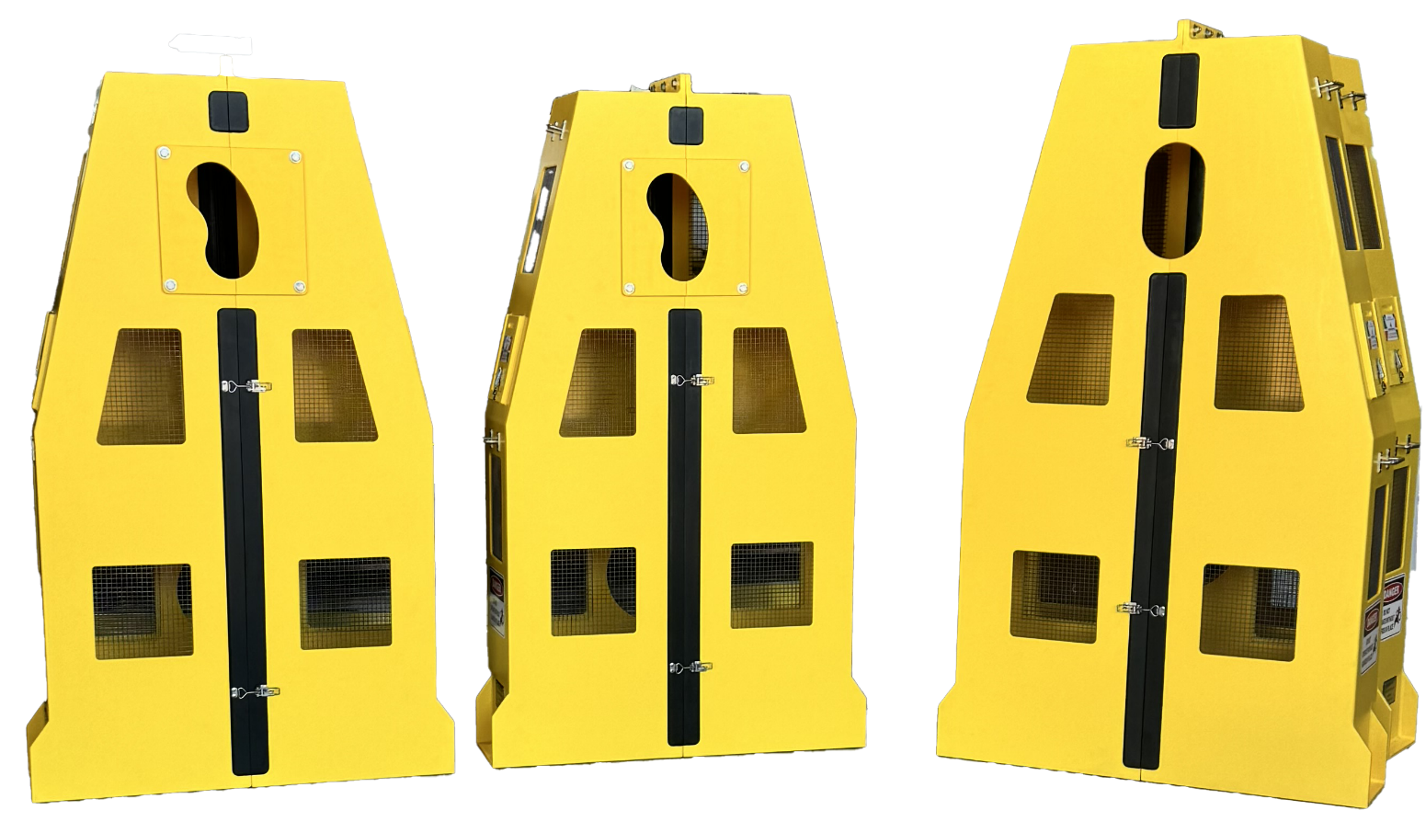
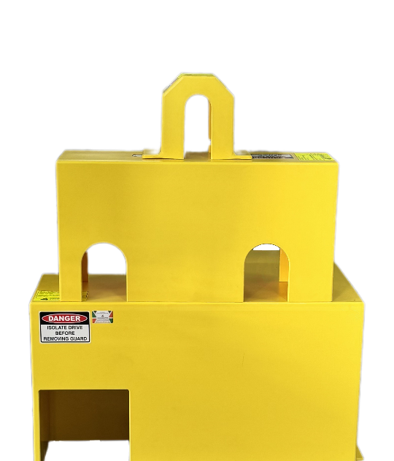
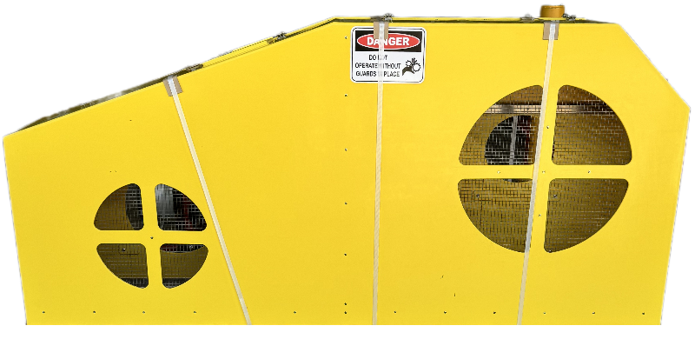
CPE's Machinery Guarding Solutions
• Pump Guards -Protect workers from moving pump parts
• Pulley Guards -Shield belt-driven equipment from hazards
• Agitator Guards - Prevent entanglement in refining processes
• Belt Drive Guards - Secure conveyors transporting mill product

Slide 6
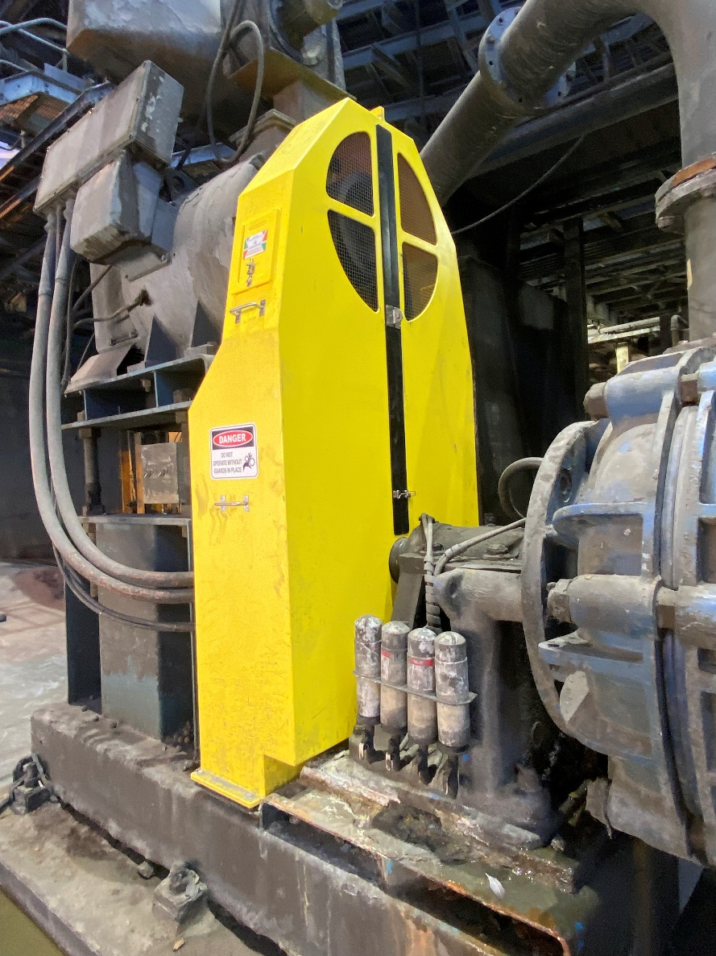
Why Machinery Guarding Matters
• Prevents workplace injuries and fatalities
• Increases efficiency and reduces downtime
• Complies with Australian safety standards
• Minimizes long-term maintenance costs

Slide 7
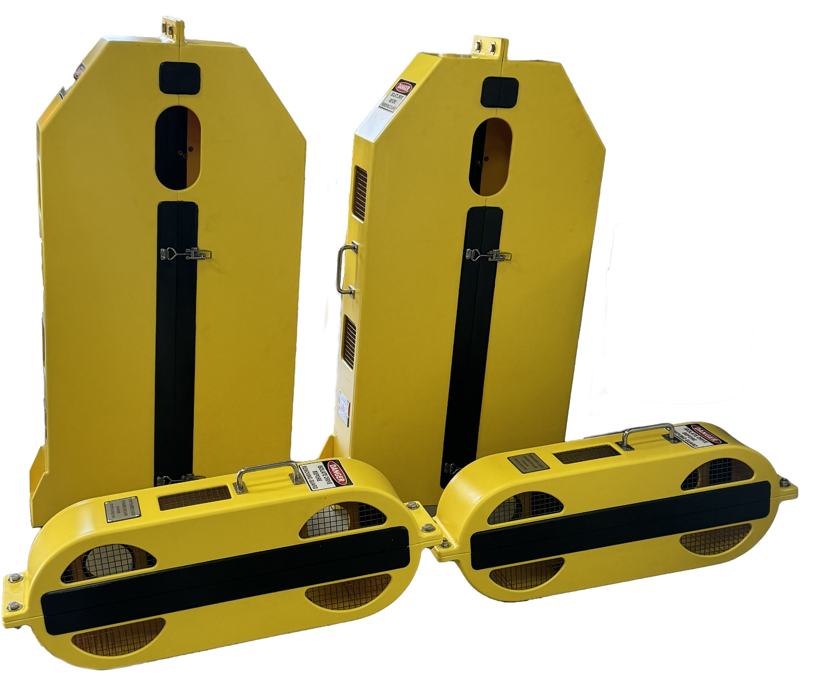
Why choose Consolidated?
• Industry-Specific Solutions – Custom-built for sugar mills
• Durable Materials – HDPE & industrial rubber for longevity
• Full Compliance – Meets AS 4024.1:2014 standards
• On-Site Support – Dedicated engineers

Slide 8
The Future of Sugar Industry Safety

Slide 9
The Future of Sugar Industry Safety
• Development of smart safety solutions
• Continued commitment to innovation & risk management
• Expanding sustainable guarding solutions
• CPE has been safeguarding sugar mills for over 35 years
• Our solutions enhance worker safety and operational efficiency
• We are committed to driving innovation in machinery guarding
• Let's make sugar mills safer together!

