Slide 1
Tully Sugar Mill - Cane Elevator Access Upgrade

Slide 2
The Cane Elevator Arrangement
When performing maintenance in the bottom half of the shredder elevator there is a need to climb over the chain rakes.
The shredder elevation construction is reasonably steep and there is a tendency for the surfaces to be slippery due to sugar cane juice and fibrous material.

Slide 3
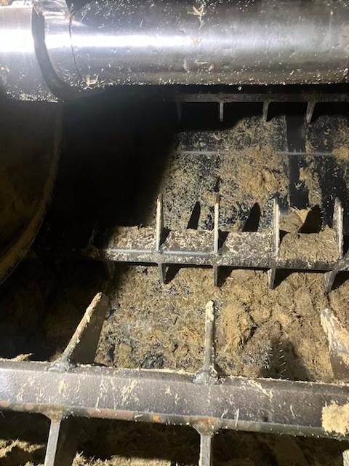
Cane Elevator

Slide 4
The process of getting to the solution
A take 5 Risk Assessment was undertaken to identify the hazards.
This in the first instance brought in hard controls, such as covers for the sharp rakes and tines. This later led into more Engineering Design, certification and construction.

Slide 5
The Solution
A set of interlockable steps was designed by Hugh Butler, an Engineering Tradesperson, to assist with accessing the shredder elevator from below.
The steps are constructed with suitably strong, lightweight aluminium and fit over the shredder elevator rakes to prevent them slipping down.
The steps provide footholds and also seating for safe maintenance activities to be undertaken.
A structural engineering firm approved the design and engineering drawings were completed for the fabrication of the steps

Slide 6
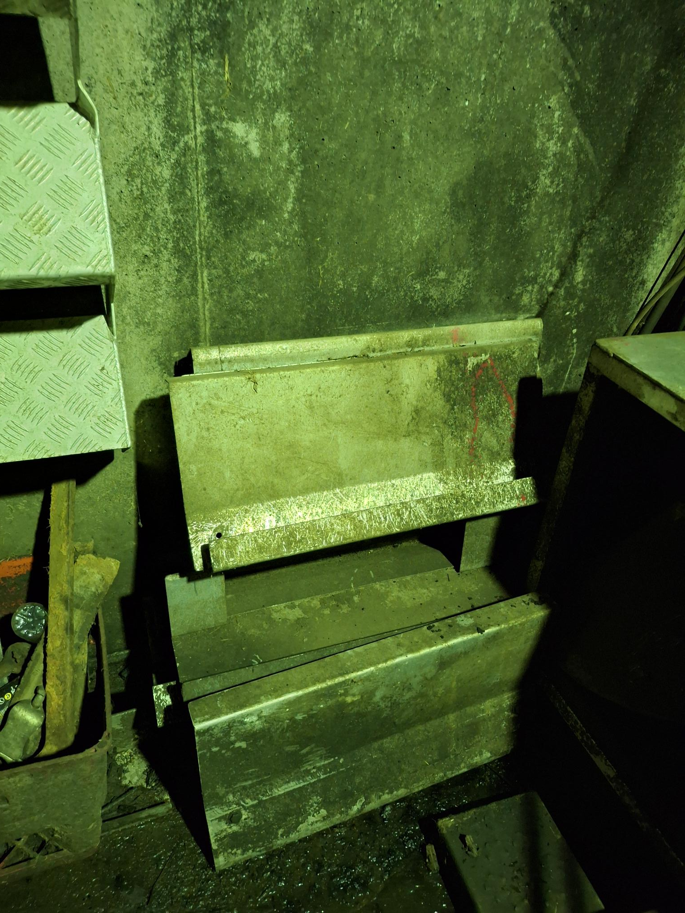
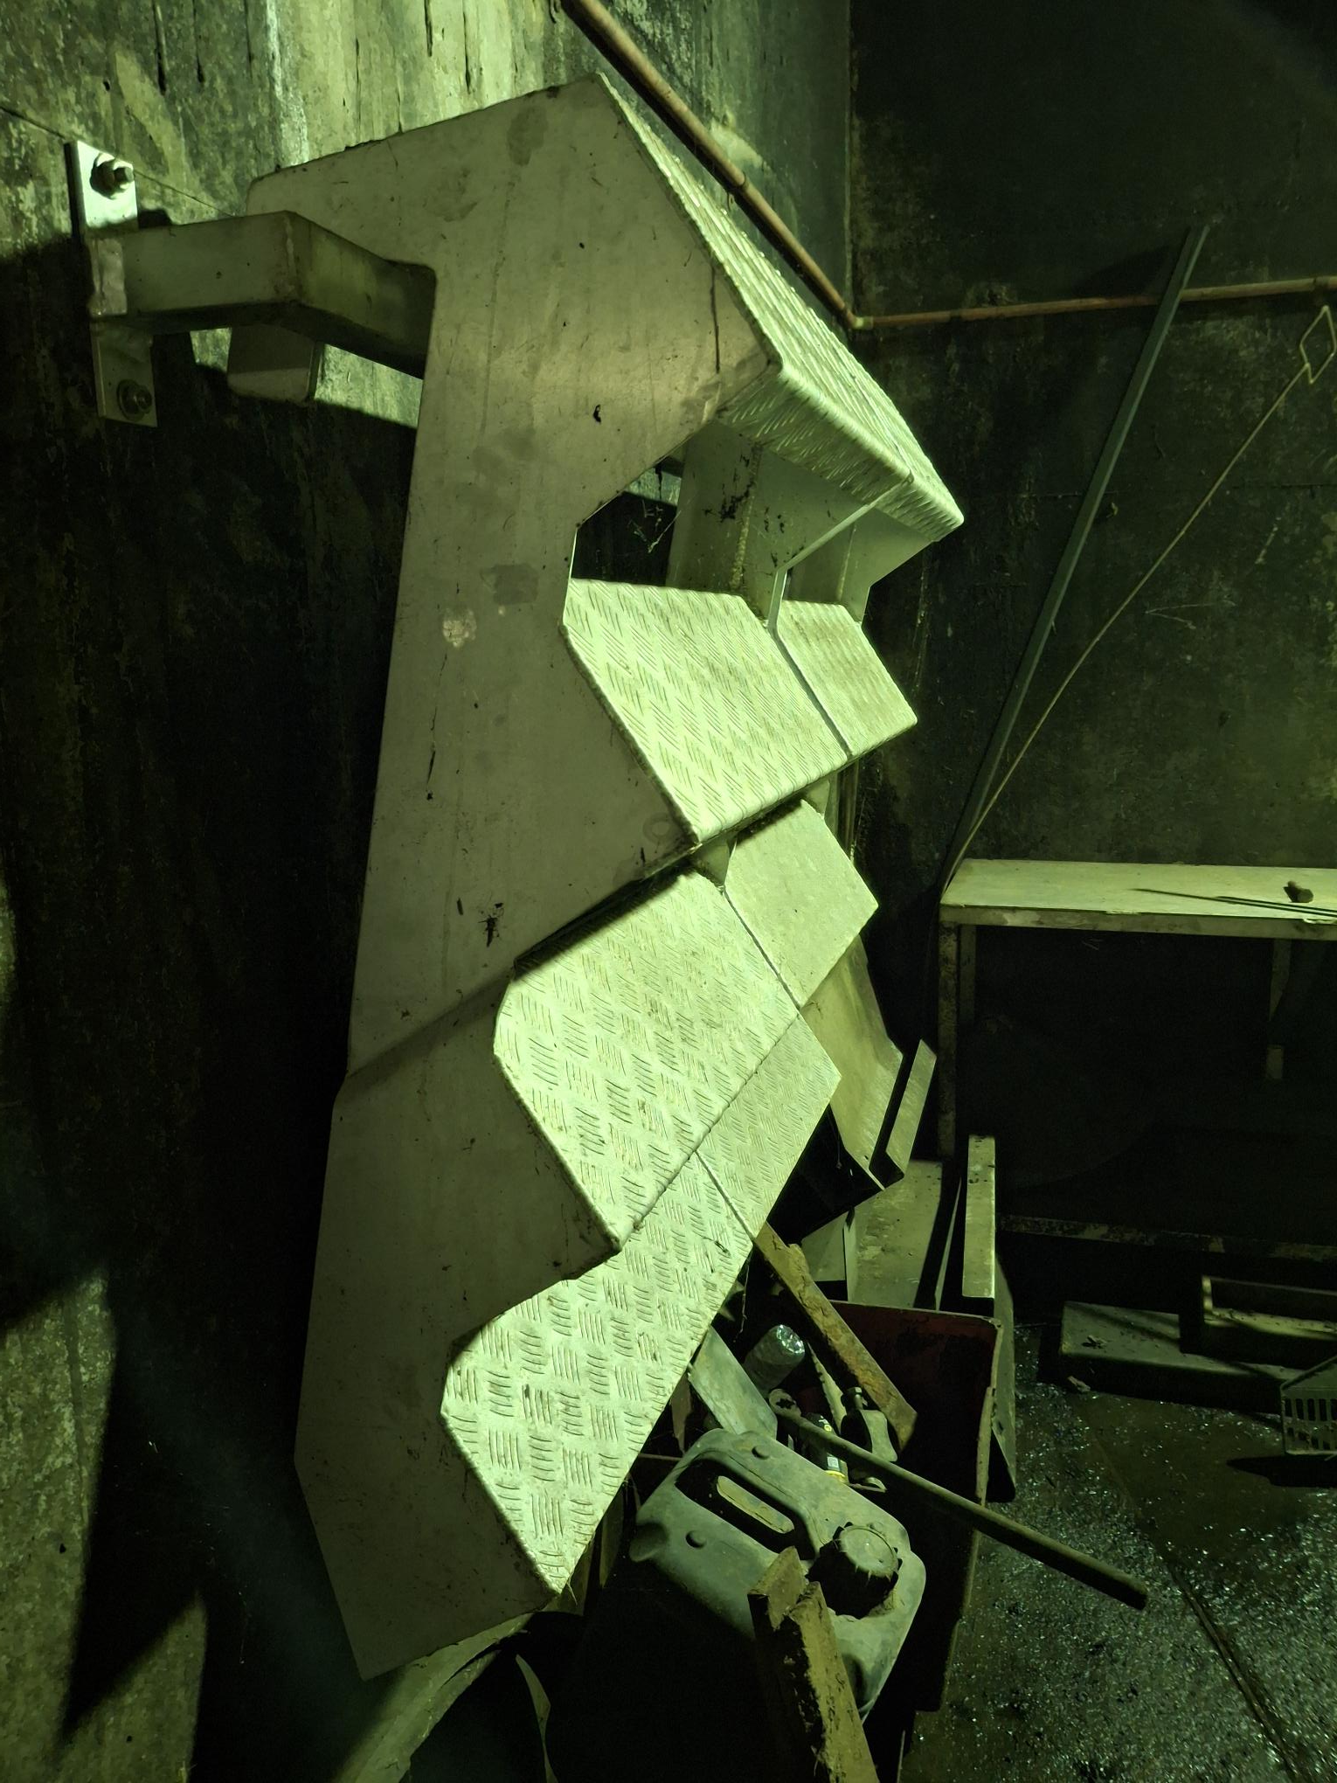
Covers & Stairs in Storage

Slide 7
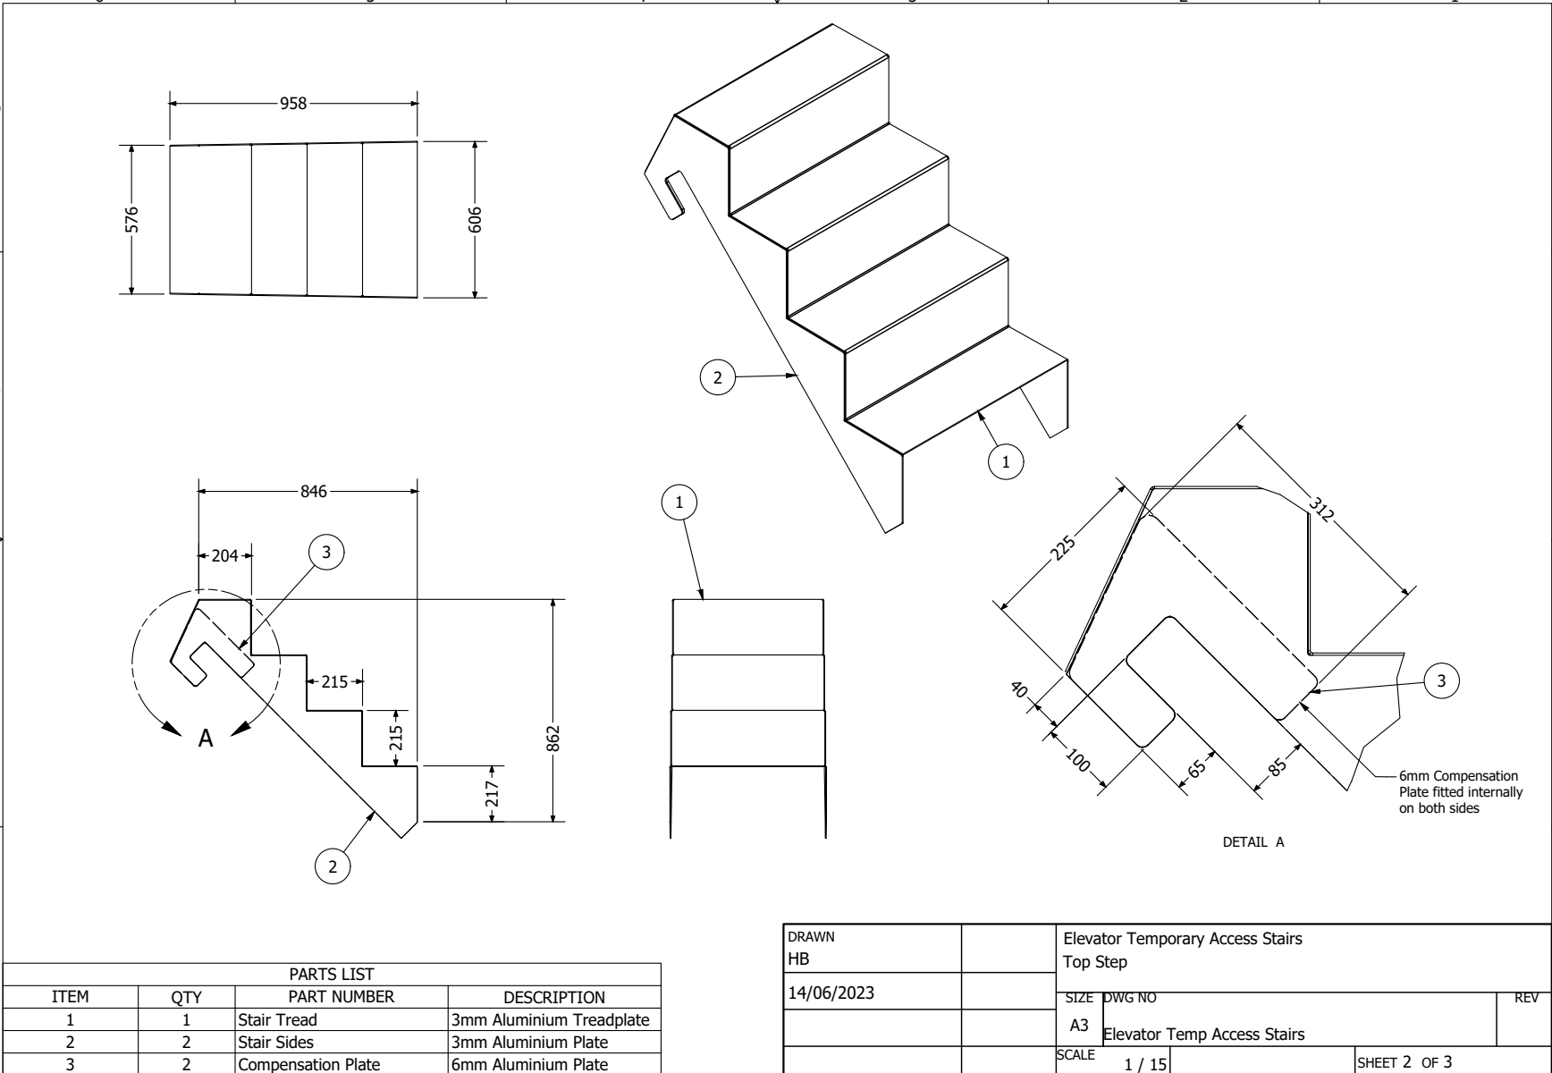
Elevator Temporary Access Stairs
The Solution

Slide 8
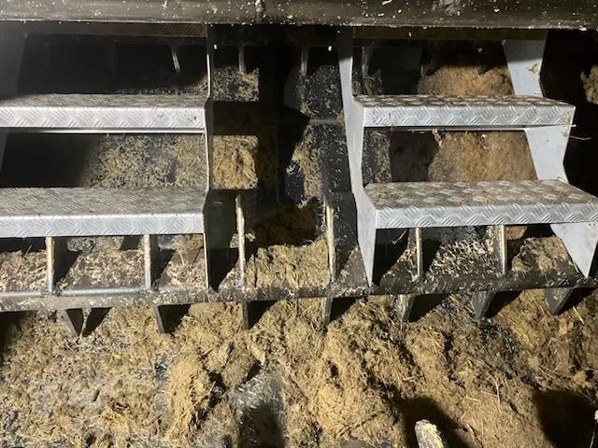
Cane Elevator Access

Slide 9
Cane Elevator Access
Safety Benefits
Maintenance activities within the confines of the shredder elevator are performed routinely on scheduled maintenance days during the crushing season as well as during the maintenance period.
Accessing and performing these maintenance activities expose workers to the risks associated with hazardous manual tasks. The interlockable steps are a proven and reliable control that has greatly reduced the risk of musculo-skeletal injuries.
The stairs are generally set up on each wall of the Elevator. The stairway arrangement can also be set up side by side to create a larger work front for assisting Boilermaking maintenance task

Slide 10
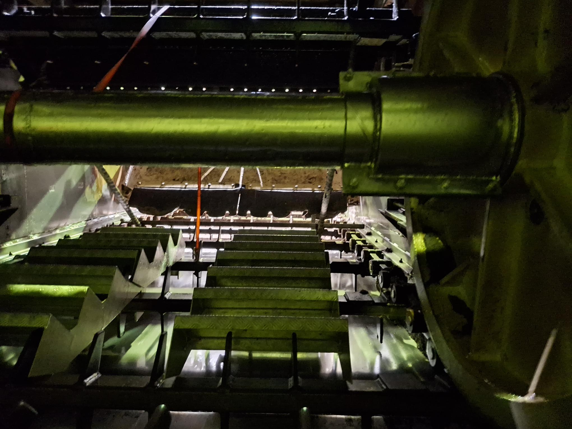

Slide 11
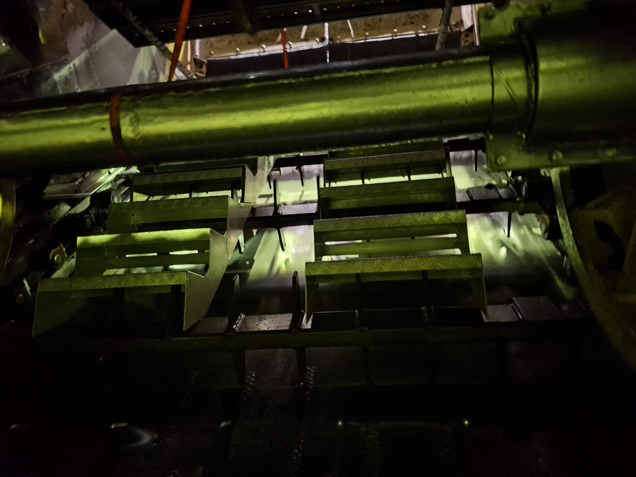

Slide 12
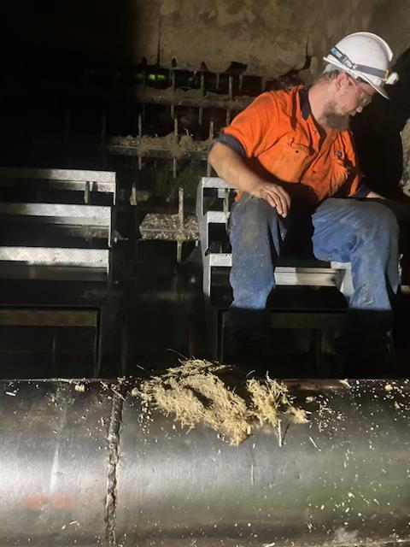
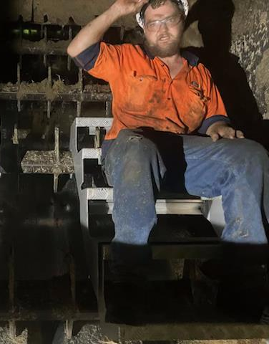
Elevator Maintenance Repairs

Slide 13
Review
Valuable solution to a workplace hazard
The Engineering Tradesperson involved in designing the interlockable steps has been recognised by both Tully Sugar Ltd and COFCO for his safety initiative.
This design could assist with access to other sloped board conveyors. There is further potential for the design to be adapted for performing maintenance tasks associated milling train intercarriers.

Slide 14
Conclusion
Next Level
In the future we hope to construct more modules to access greater areas of the elevator.
Possible handrails could be added to the side of the work stairs for a greater level of protection to the worker.
The TSL Engineering Team hopes one day this concept will be used in other areas of the mill, and throughout the sugar industry.

Slide 15
Questions

Slide 16
Thank you

