Slide 1
Enforceable undertakings – Key Learnings for a sugar business
Jacob Watson
HSE Manager
Mackay Sugar
ASMC 2025

Slide 2
Setting the scene
On 2 September 2021, two employees of MSL attended effluent ponds at Abbotts Road, Palmyra in the area surrounding the Racecourse Road Mill to obtain water quality samples.
During the course of obtaining the sample an employee applied pressure to a rotating belt which resulted in their fingers were being caught in the belt of a water pump causing de-tipping injuries to the employee’s fingers. The pump involved was owned by a grower adjacent to the Racecourse Mill effluent ponds at the time of the incident it was unguarded and in poor condition.
Mackay Sugar was not responsible for the maintenance or upkeep of the pump at the time of the incident and use of the pump was not mentioned in any process or procedures associated with the pond sampling tasks.

Slide 3
WHSQ notices
Date issued | Notice type | Notice number | Contravention or prohibited activity | Action taken in response to notice
02.09.2021 | Prohibition Notice | P1012363 | WHS Act 19(3)(d), s 32 Workers operating the unguarded effluent ponds pumping systems including the priming pump and the main pump until an inspector is satisfied that the matters that give rise to the risk have been remedied. | MSL installed guarding on the priming pump and a cooling fan.
02.09.2021 | Non-disturbance notice | NDI1009053 | Ensure that the workplace incident scene Effluent Pond Pumps and pumping station known as Peterson Pump at Abbotts Road is barricaded off in a manner that prevents access by workers and others and that the area remains undisturbed | Area barricaded to prevent access by employees or others.
02.09.2021 | Non-disturbance notice | NDI1009054 | Ensure that the workplace incident scene Effluent Pond Pumps and pumping station known as Peterson Pump at Abbotts Road is barricaded off in a manner that prevents access by workers and others and that the area remains undisturbed | This was issued to the owner of the pump – PNS Farming. Mackay Sugar barricaded the pump shed and performed rectification works on their behalf.

Slide 4
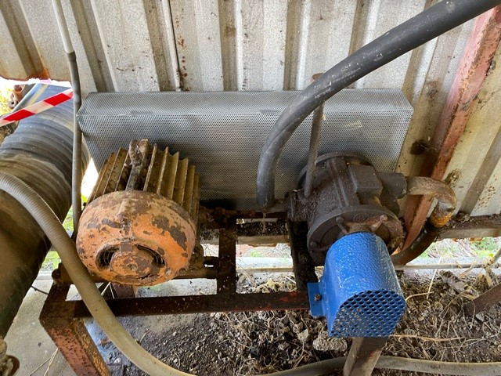
Grower owned priming pump
Prior to guarding installation
Post guarding installation

Slide 5
Prosecution against Mackay Sugar under the WHS Act
Charges were laid against the company alleging a continuing breach of the Work Health and Safety Act 2011 (Qld) between 1 March 2020 and 2 September 2021.
Mackay Sugar engaged Herbert Smith Freehills (HSF) on our behalf to initiate an application for an Enforcable Undertaking.
What is an Enforceable Undertaking:
An enforceable undertaking (EU) is an alternative to a court-imposed sanction, such as a fine, for an alleged contravention of the Work Health and Safety Act 2011, Safety in Recreational Water Activities Act 2011 and the Electrical Safety Act 2002 (the safety Acts).
A commitment by the person to disseminate information about this undertaking to workers, and other relevant parties
Activities to be undertaken to promote the objects of the safety Acts that will deliver benefits for workers/others
Activities to be undertaken to promote the objects of the safety Acts that will deliver benefits for industry
Activities to be undertaken to promote the objects of the safety Acts that will deliver benefits for community
An EU is not an admission of guilt

Slide 6
MSL process and working with EU unit
Overall positive engagements with the Enforceable Undertakings Unit advisory service, Office of Industrial Relations
The advisory service will not give you initiatives for the EU however they will provide guidance on how to build on your ideas to increase your chances of the EU being accepted.
Mackay Sugar submitted multiple draft EU for feedback – Feedback was direct but helpful in building initiatives, feedback was received from multiple people within the EU team and broader OIR teams.
Overall, after reviewing the final draft for submission, it was decided to withdraw from the EU process due to substantial amount of work currently in place to rectify aspects of the EU. OIR outlined risk regarding MSL compliance history with enforcement actions dating back to early 2000.

Slide 7
Summary
Although MSL had a documented procedure for taking water samples via a syphon and not a pump, the procedure to utilise the syphon was not followed.
Take Note - If an employee touches an item whether you own it or not, its deemed within your ownship and are required to maintain it accordingly.
Review shared or grower owned equipment or infrastructure on your land or close to your operating areas.
Verify in the field, any equipment or tooling being ustilised by your employees, especially in remote locations – the risk is high!

