Slide 1


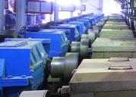
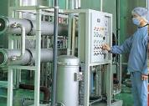



High Risk Work Verification of Competency (VoC) Project
2025 ASMC Conference
Tara Cesconetto,
EHS Training Coordinator
Sugar and Renewables

Slide 2
Agenda
Introduction
Background
Implementation Steps
Challenges Faced
Key Outcomes
Lessons Learned

Slide 3
Introduction & Background
This presentation summarises an improvement project from recommendations from two years of high-risk auditing at our sugar milling factories.
Sugar and Renewables has a robust OHS Management System that meets National Self Insurer requirements - ISO 45001.
Through auditing all sugar mill factories, we identified gaps in the practical application of high-risk work activities.
A two-year project commenced January 2024 to address the gaps
Our specific challenge is to verify the practical competency of the individuals required to undertake high-risk work.

Slide 4
Solution Overview
Develop a program to manage the ongoing verification of competency (VoC) for high-risk work activities.
The program, developed by a small team will continue to:
Engage subject matter experts – Group EHS Learning and Development, Site Leaders and workers for content
Involve Key Stakeholders – Sugar & Renewables Learning and Development, People and Culture, Group Managers, Supervisors, EHS Network members and Workers
Build solutions based on our existing processes and programs
Utilise Group EHS LITMOS training to enhance our current high risk work procedural training packages.

Slide 5
Implementation Steps
Develop training framework for high-risk work verification of competency for permit to work, isolation, confined space, working at heights and hot work.
Apply a process to formally approve an employee as competent to issue work permits
Review how the permit to work process is being applied to high-risk work tasks
Review physical isolation of equipment process for ongoing effectiveness
Review the Take 5 for ongoing effectiveness as the low-level risk assessment tool
Set up a factory permit to work steering team for the ongoing management of high-risk work.

Slide 6
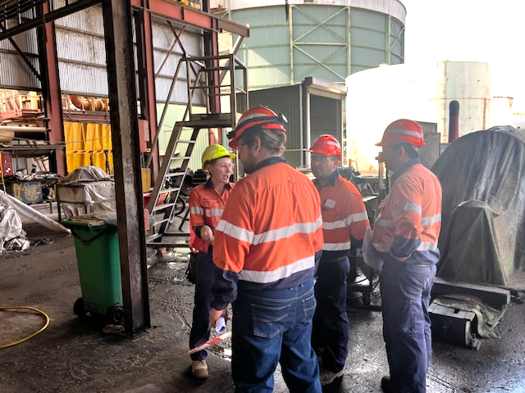
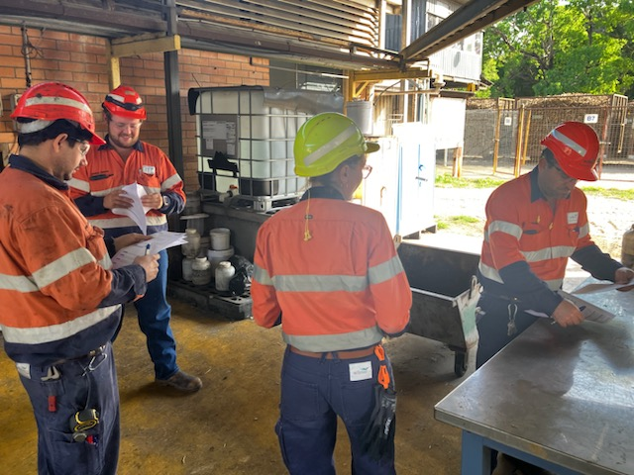
Challenges Faced
Availability of participants for assessing during the operational season.
This is being resolved by:
Aligning practical testing with operational activities to ensure attendance.
Testing on the job, observing and assessing during planned high-risk work.

Slide 7
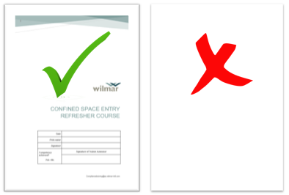
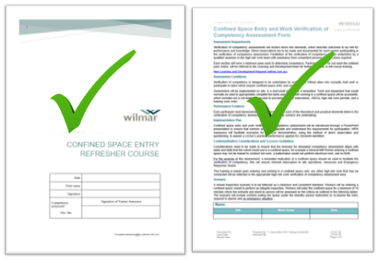
Key Outcomes
Positive results
We now have a practical competency assessment in our safe systems of work
Impacts achieved
Workers can now be verified as competent in high-risk work.
Workers have gained a better practical understanding of the permit to work system through assessment on the job, this in turn has improved the planning of high-risk work tasks.
BEFORE
No practical competency assessment
Nationally Accredited Training
AFTER
practical competency assessment in our Safe Systems of Work
Notes:
Photo of CSE and/ or WaH assessment.
Theory and practical before and after.

Slide 8
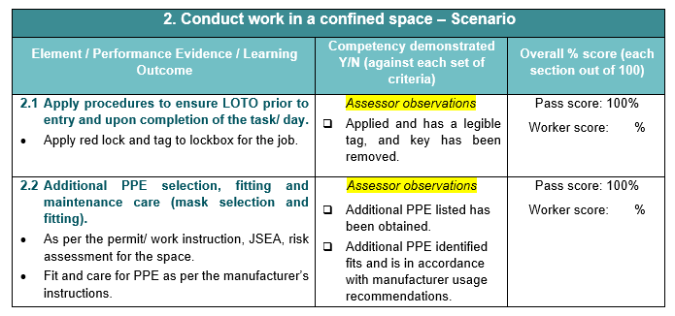
Example of practical competency assessment for Confined Space

Slide 9
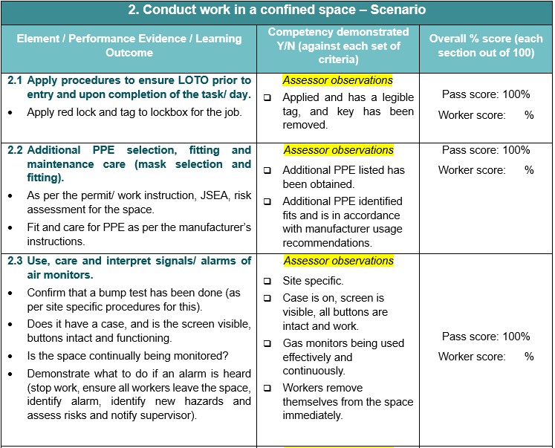
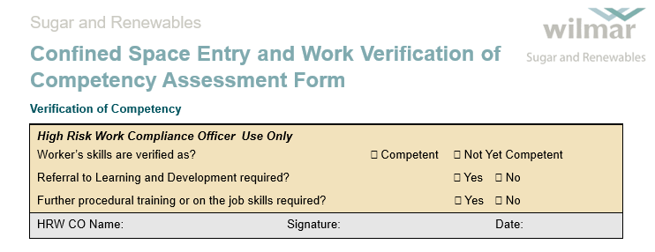

Slide 10
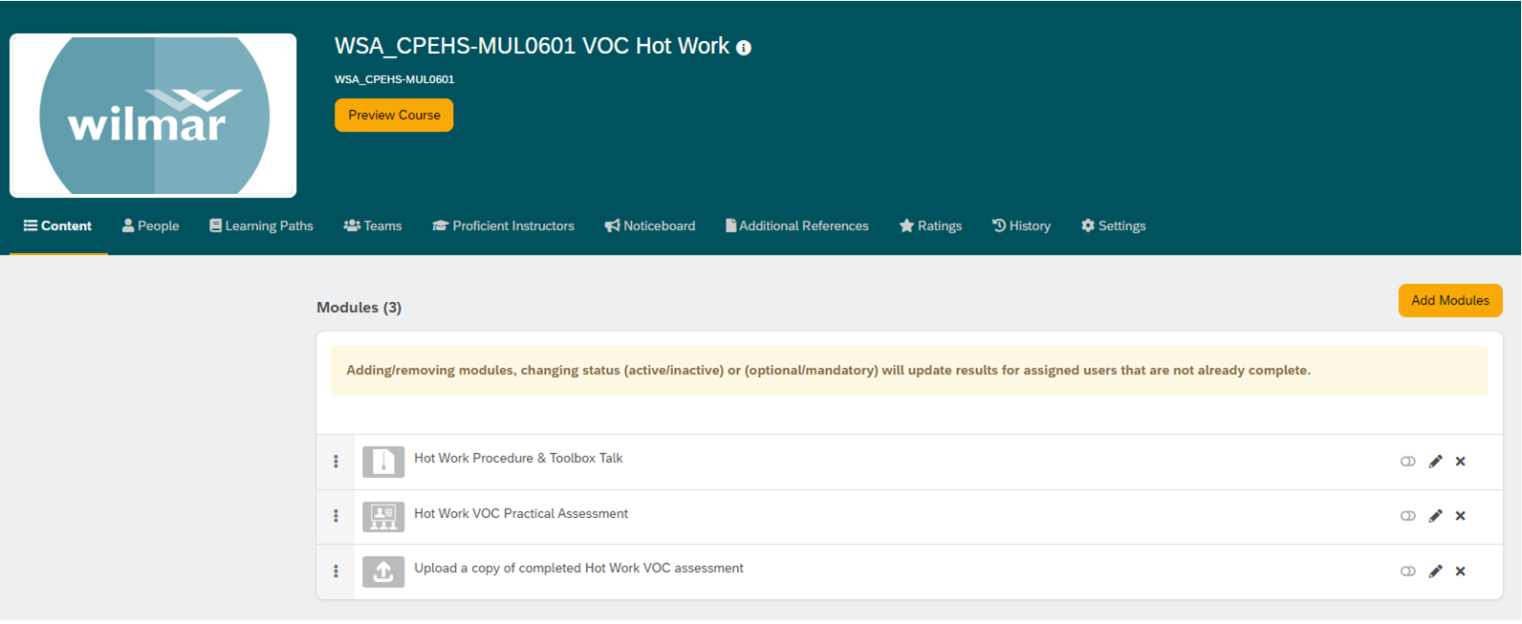
LITMOS course development
Procedural training forms a module in the VoC course to ensure a current knowledge and understanding of Wilmar safe systems of work and high-risk work procedures.

Slide 11
Records Management & Reporting
VoC records will be held in LITMOS, a Wilmar engaged learning management system (LMS).
Reports are generated and forwarded to reporting lines on an automated schedule.
A team leader in LITMOS will be able to access the records for their team members.

Slide 12
How long is a person deemed competent once VoC is achieved
We will follow the standards for current high risk refresher training which is:
Minimum of 2 years
Maximum of 3 years
VoC replaces the need for refresher training where a person is deemed competent.
If VoC is not achieve we default to scheduling full refresher training which will now include procedural training in LITMOS.

Slide 13
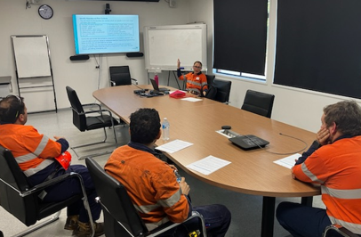
Lesson Learned
Nationally accredited training alone does not equip workers with the practical skills and confidence to implement the requirements on the job.
Workers need to be competent in implementing safe work practices to meet the safe systems of work.
What worked well
Content in the classroom
Adapting assessment to operational timing
What could be improved
Feedback from the on-the-job assessments will lead to improved process.
Notes:
Workers gained confidence in implementing and understanding the authority to work procedure and it’s intended purpose.
Also in understanding their roles further and why they do what they do.

Slide 14
Sustainability & Future Plans
Best practice will be sustained and integrated into ongoing operations through:
Dedicated resourcing to continue the program.
Capturing valuable knowledge from experienced subject matter experts.
Continual improvement of procedures, permits, training, inspections and audits.
Utilising the full functionality of LITMOS.
Notes:
For the program to be successful it has to be appropriately resources in the future.

Slide 15
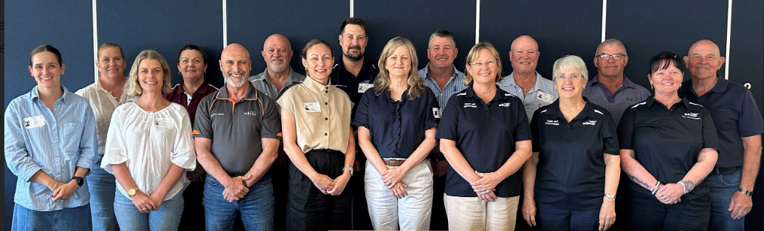
Thank you.
Wilmar Sugar and Renewables EHS Network

