Slide 1
The Human Factor…
Notes:
I’ve been to countless safety conferences such as these, across many different industries. We hear from the worlds greatest speaks on topics on reducing all types of workplace injuries.
When we look at the greatest contributor to workplace incidents, machinery operators and drivers have 6x the fatality rate, with 42% of all workplace fatalities due to vehicle incidents.
At these conferences, many talk about all the implementations they have been successful with

Slide 2
Despite lower than global injury rates, Australia has seen 1,880+ traumatic fatalities
Australia’s work-related injury rate of 3.5%, is roughly 1/3 the global rate of 12.1%.¹
In 10 years, Australian workplaces saw 1,880 fatalities and 1.16 million serious compensation claims
¹ Australian Bureau of Statistics, Work-related injuries survey, 2021-22; International Labour Organisation estimates of work-related injuries and employment (2019).

Slide 3
Sugar milling is involved in 50% of activities relating to 76% of traumatic fatality.
76% of work-related traumatic injury fatalities and 61% of serious workers’ compensation claims occurred in just 6 industries:
Manufacturing
Transport, Postal and Warehousing
Agriculture, Forestry and Fishing
Construction
Public Administration and Safety
Health Care and Social Assistance
²Key Work Health and Safety Statistics Australia 2024

Slide 4
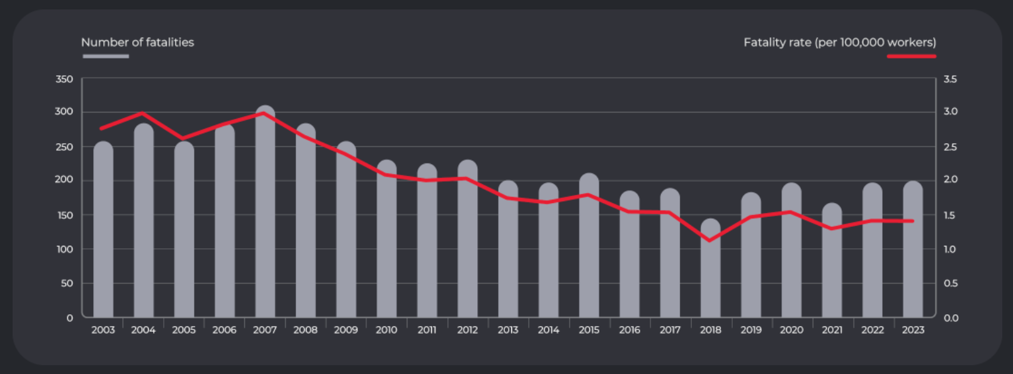
Despite continued efforts, average death rates have not reduced in the last 5 years
2023, 200x workers died
5% higher than the previous 5-year average
Consistent with the current 5-year average

Slide 5
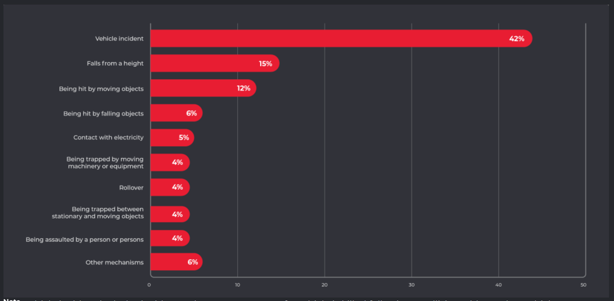
42% of all fatalities in Australia are due to vehicle incidents.
Vehicle incidents continue to account for the largest proportion of worker fatalities (42%; 84 fatalities).

Slide 6
Machinery Operators & Drivers 6x the overall fatality rate
Machinery operators and drivers, the highest proportion fatalities (37%)
The highest fatality rate at 8.3 fatalities per 100,000 workers – 6X the overall fatality rate (1.4 fatalities per 100,000 workers).

Slide 7
When death rates are not changing, what must change?
Notes:
I’ve been to countless safety conferences such as these, across many different industries. We hear from the worlds greatest speaks on topics on reducing all types of workplace injuries.
When we look at the greatest contributor to workplace incidents, machinery operators and drivers have 6x the fatality rate, with 42% of all workplace fatalities due to vehicle incidents.
At these conferences, many talk about all the implementations they have been successful with

Slide 8
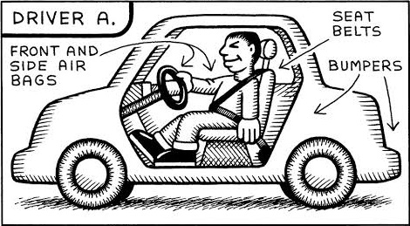
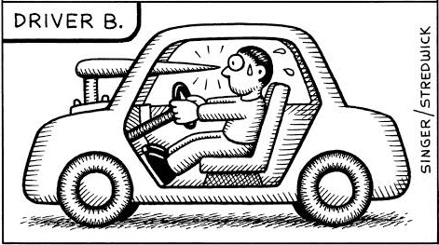
Humans change their behaviour based on their perceived level of risk
Notes:
It’s interesting, that when you look at the research of Sam Peltzman, professor emeritus at the Booth School of Business, University of Chicago, he shows that when cars went from no seatbelts to seatbelts, the number of car accidents grew so much that it almost negated the safety impact intended.
In the 80’s when cars were introduced with ABS brakes, cars fitted with ABS brakes had more accidents than cars without.
In both cases, it was found the unconscious psychological safety net that these technologies instigated, caused the drivers of these vehicles to drive faster, brake later and consistently take more risks, believing the new technology would save them – rather than using their own judgment to keep themselves safe.
Looking at these images for a moment…. Which of the two drivers will exhibit more cautious behaviour?
When there's no risk or nothing at cost, we tend to behave carelessly and the moment risk gets involved, we become more alert, careful & conscious of our actions. This phenomenon is known as Peltzman effect/ Risk compensation theory.

Slide 9
Compounding Causes of HPI & Fatalities
Human Behaviour
↓ Risk Perception
Lack of Risk Awareness
Large Objects
Absence of light
Notes:
Lack of Risk Awareness
We have generations of workers coming through that have never experienced small risks and do not have the cognitive ability to do so.
Childhoods robbed of burning bums down metal slides in summer, swings you fall off onto hard concrete, trees never climbed, and trampolines that are impossible to fall off or break a bone
What seems logical to anyone over 40, is not logical to the prior generations that never experienced the consequences of risk
Lowered Risk Perception
No / low rates of incidents for a period of time
Technological avoidance
Human judgment of large objects
Biological in all humans
Humans have extreme difficulty judging distances of larger objects. The larger the object is, the harder it is for humans to determine its distance.
Moving objects are hard for humans to determine its distance, so moving large objects are hard to judge its distance.
Having no indicators of approaching speed (trees, posts etc)
Compounding Effect of low light
Biological in all humans
Couple that with darkness… now coal is the most light absorbing product in the world, so our coal pits and underground are the most difficult places to light up and are potentially the darkest places in the world! Trying to judge a large moving vehicle in what in one of the darkest parts of the world poses an exceptional challenge.
I am not surprised that coal has the highest rates of incidents.
Because of these three key factors, our people are not instinctively judging risk, causing high risk behaviour.

Slide 10
Neuroscience.
The key to safe behaviour has been there the entire time.
Notes:
So how do we do it? The answer lies in neuroscience.
If we can trigger a human's instinctive response to danger, their unconscious self-preservation mechanism will kick in and will instinctively remove themselves from danger well before the danger can occur.

Slide 11
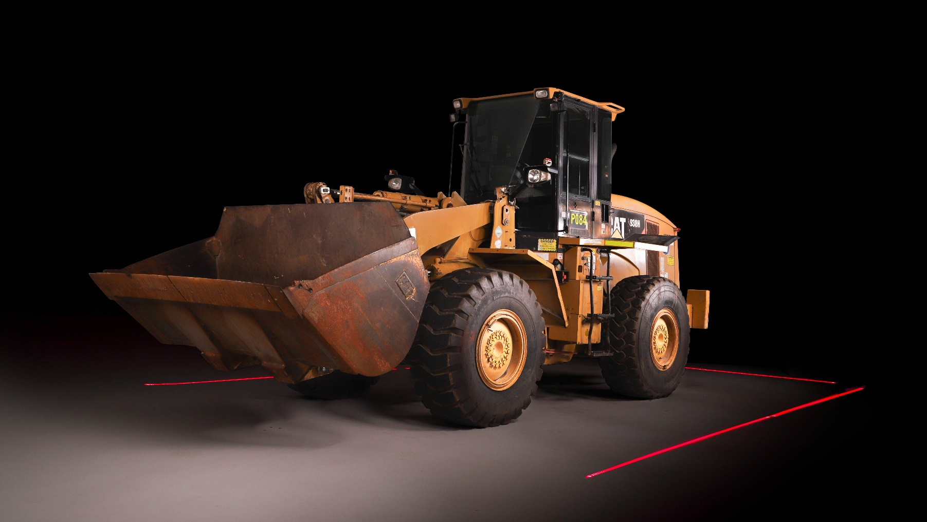
WORLD’S FIRST EXCLUSION ZONE FOR ALL MOBILE PLANT Because everyone deserves to get home safely.

Slide 12
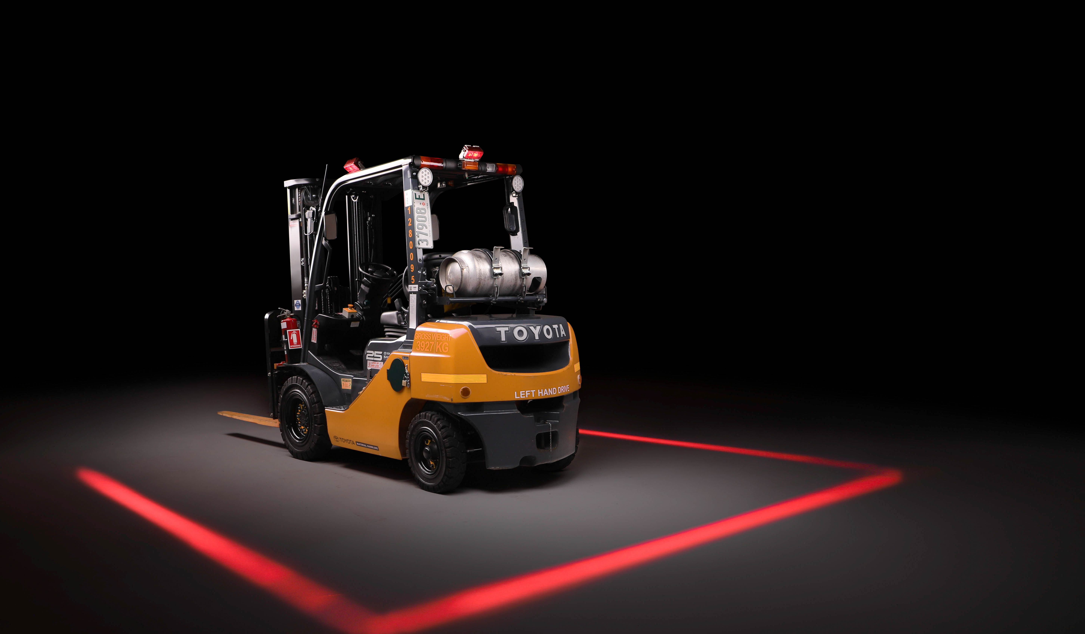
Changing Human Behaviour
IMPROVES SAFE HUMAN BAHAVIOUR
An obvious “red zone” triggers an intrinsic danger reflex for both the Operator and Pedestrian, subsequently changing human decision-making behaviour to remove the risk of harm.
SAFER THAN ENGINEERED BARRIERS
Engineered or technological barriers reduce a human's perceived level of risk as they rely on the intervention to keep them safe, resulting in poor human decision making and increased incidents.
ENFORCEABLE ACCOUNTABILITY
For the first time ever, there is absolute clarity on the distance to be kept from mobile plant, providing a clearly enforceable line that cannot be crossed.

Slide 13
The Impact of Good Design

Slide 14
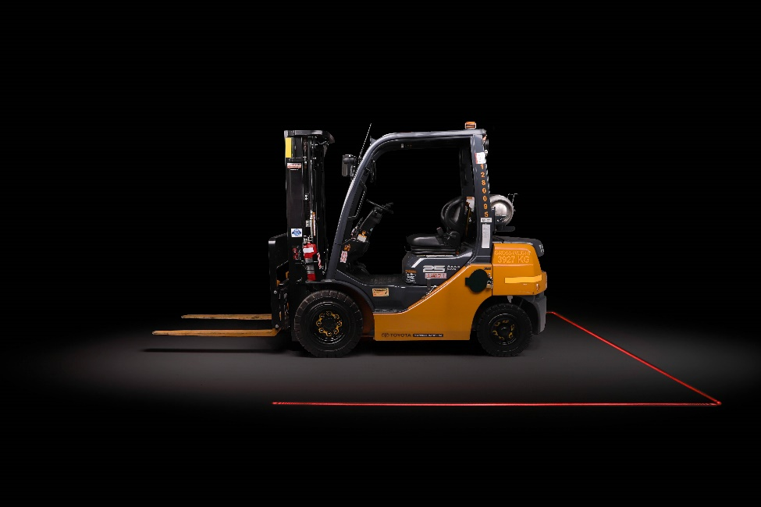
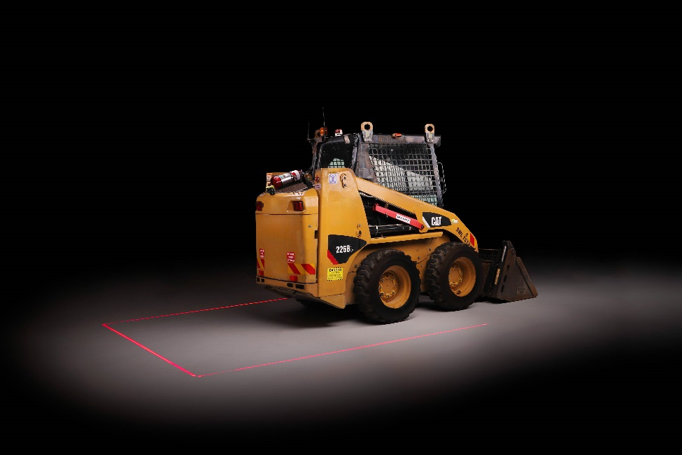
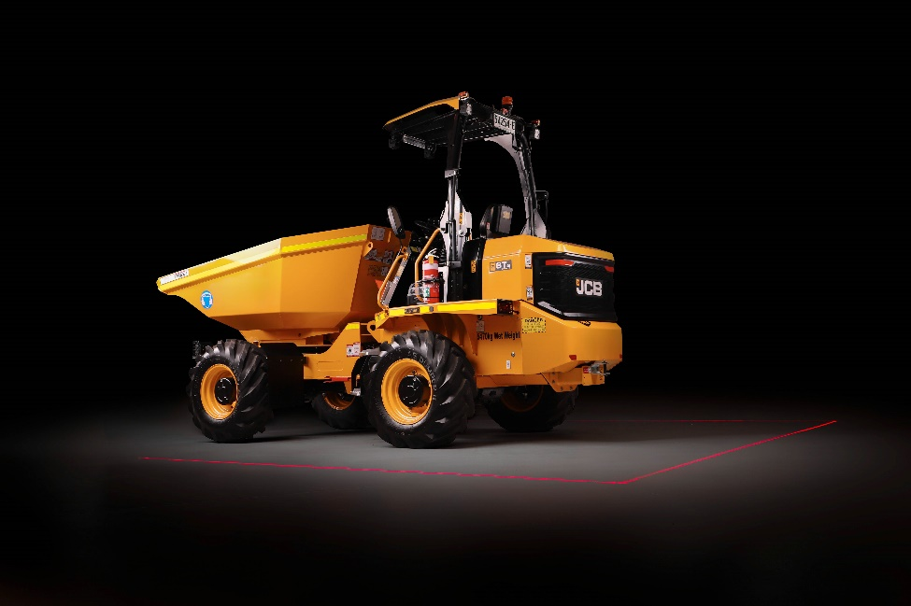
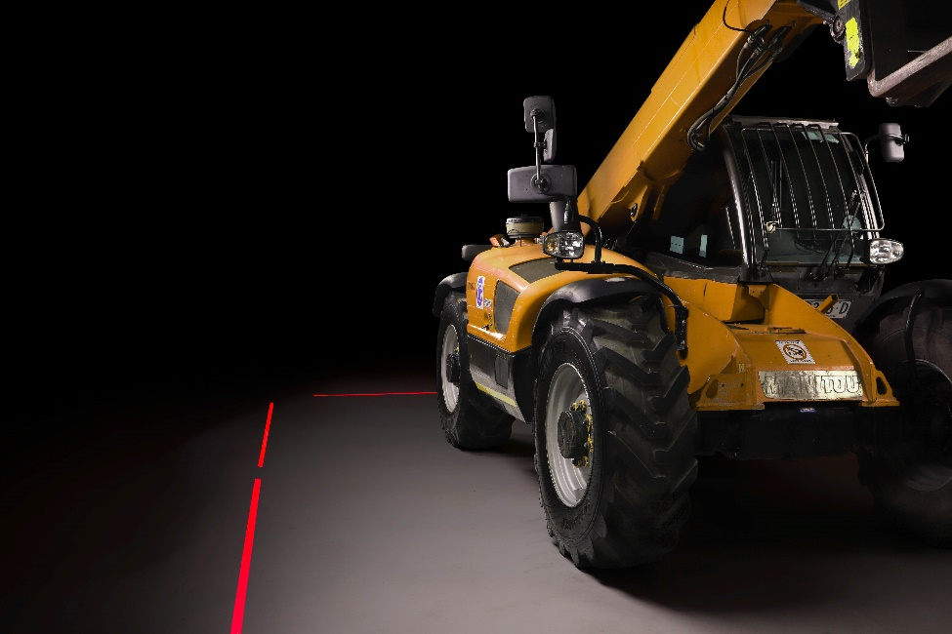
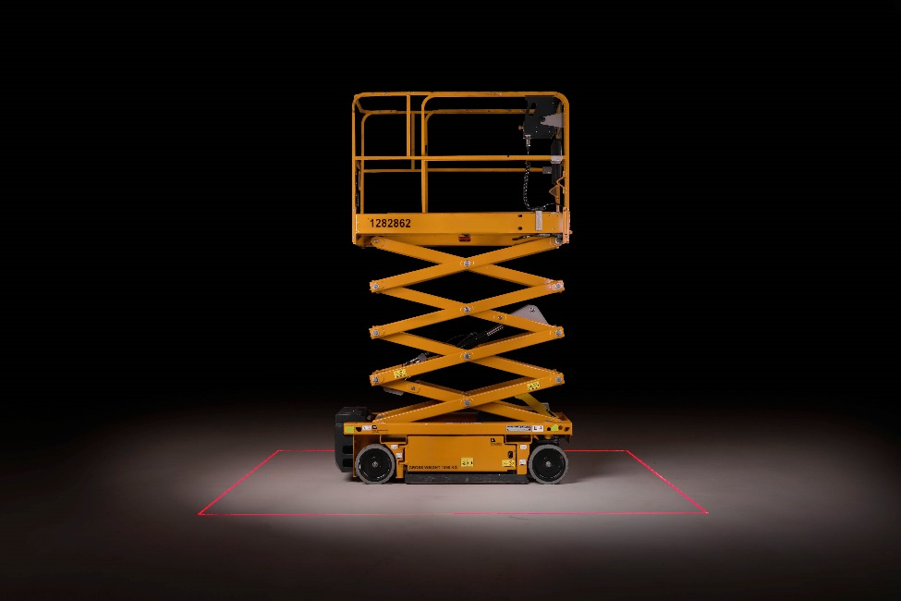
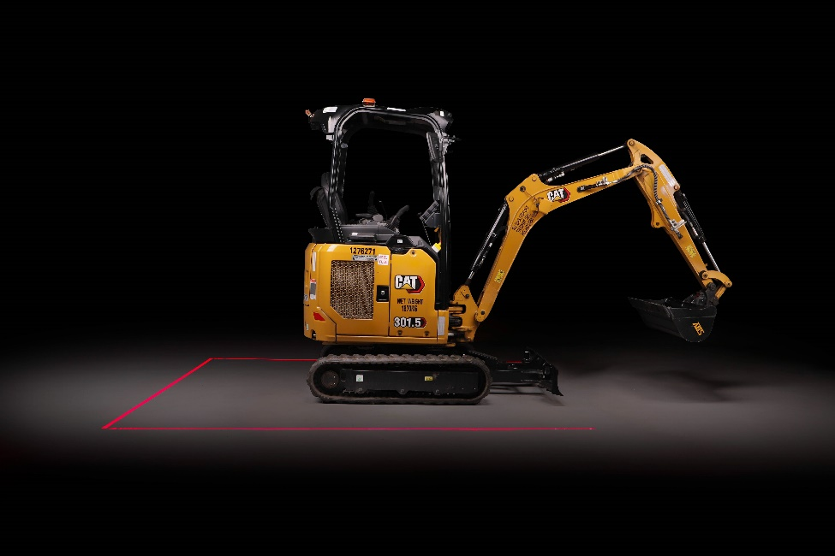
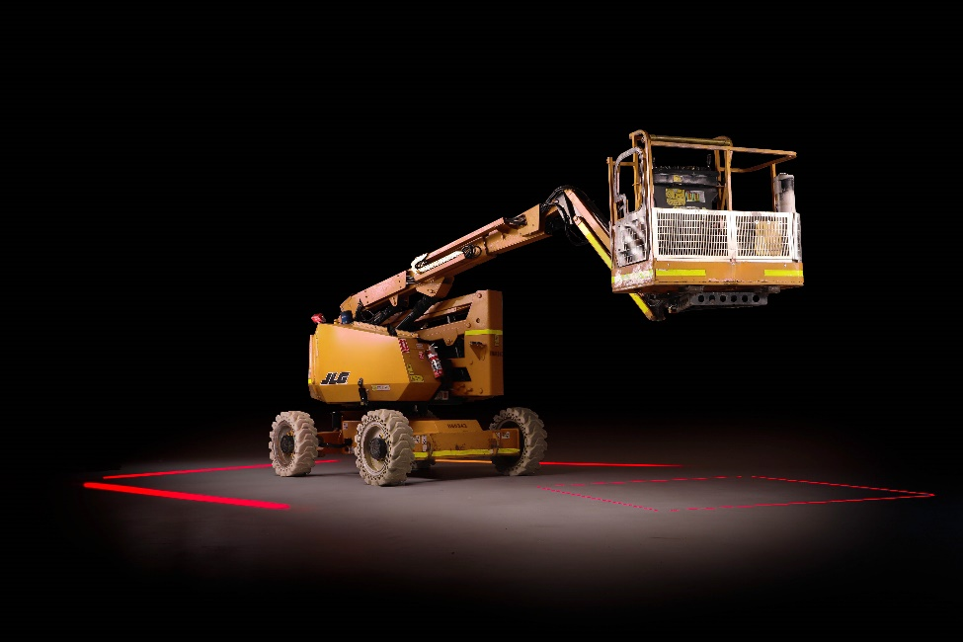
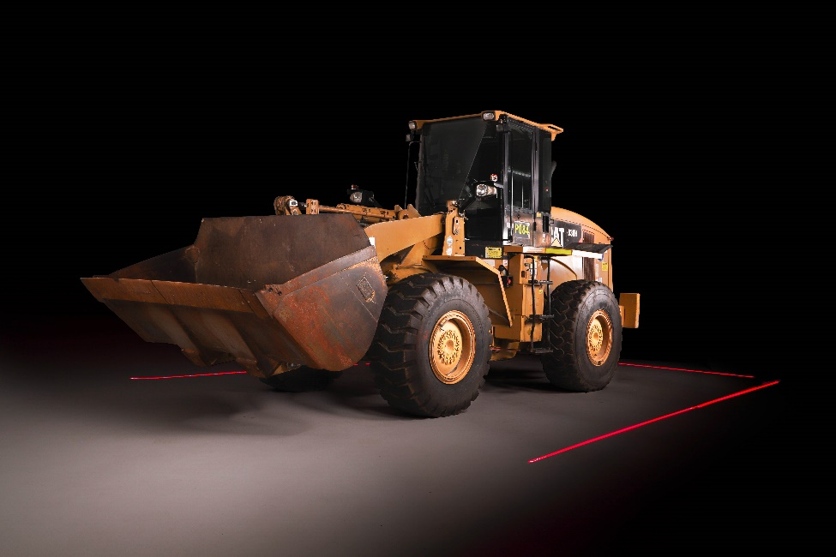
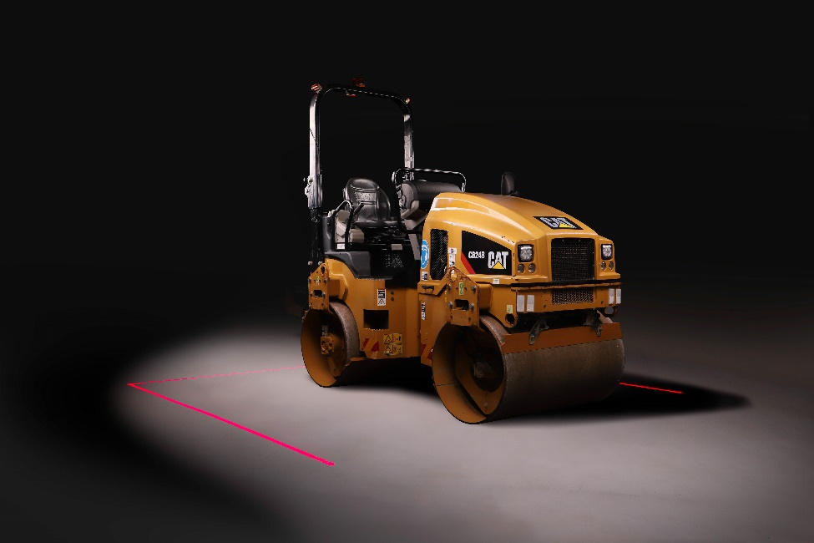
All Machinery Great or Small

Slide 15
Projected Walkways & Proximity Awareness

Slide 16
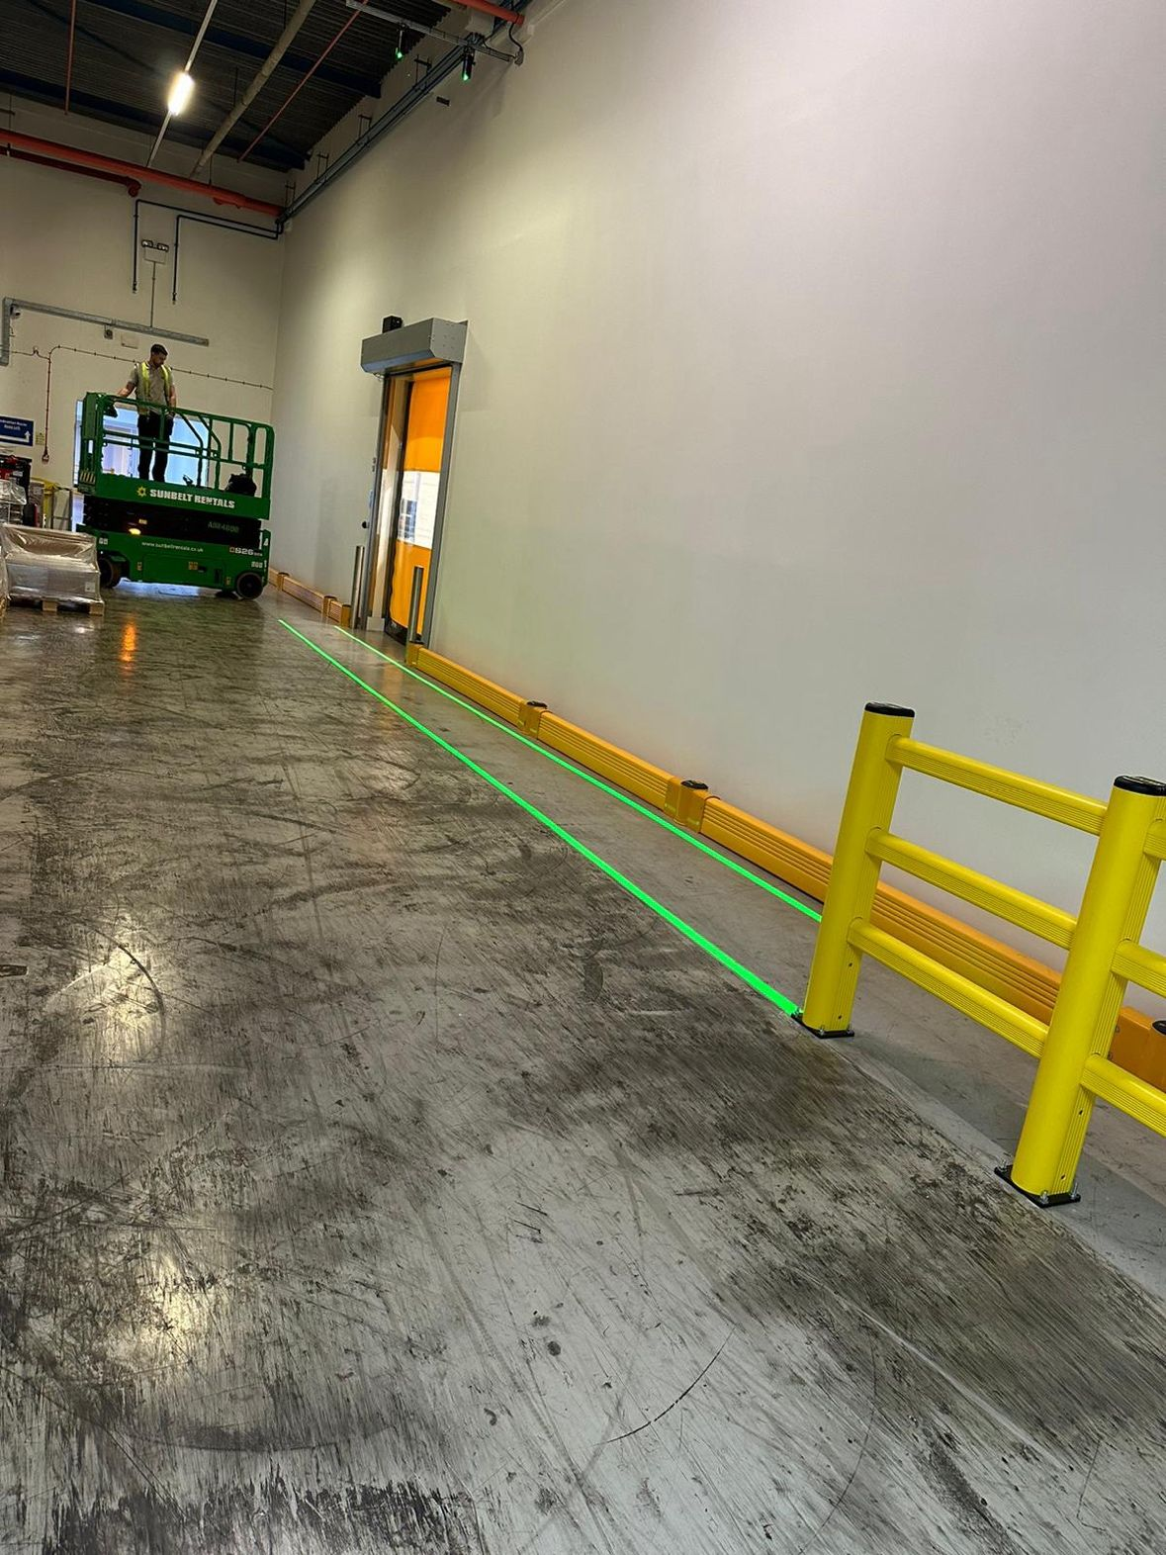
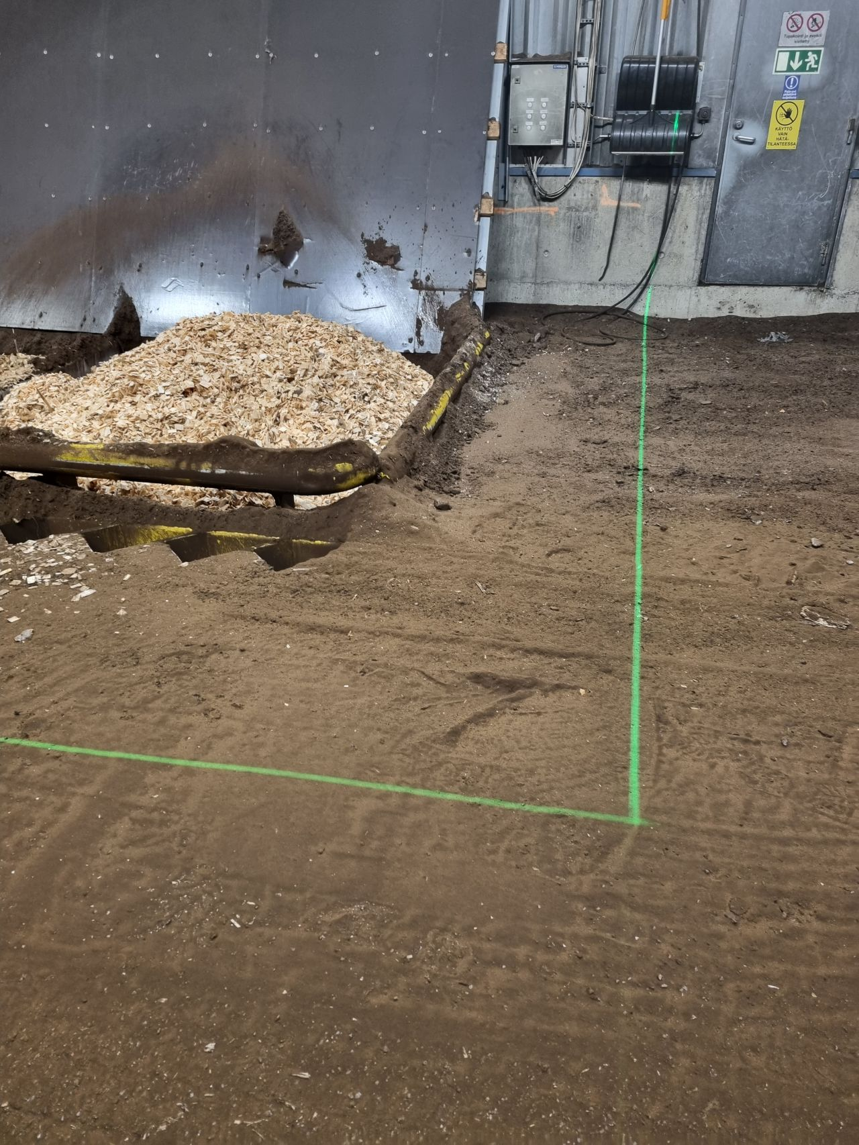
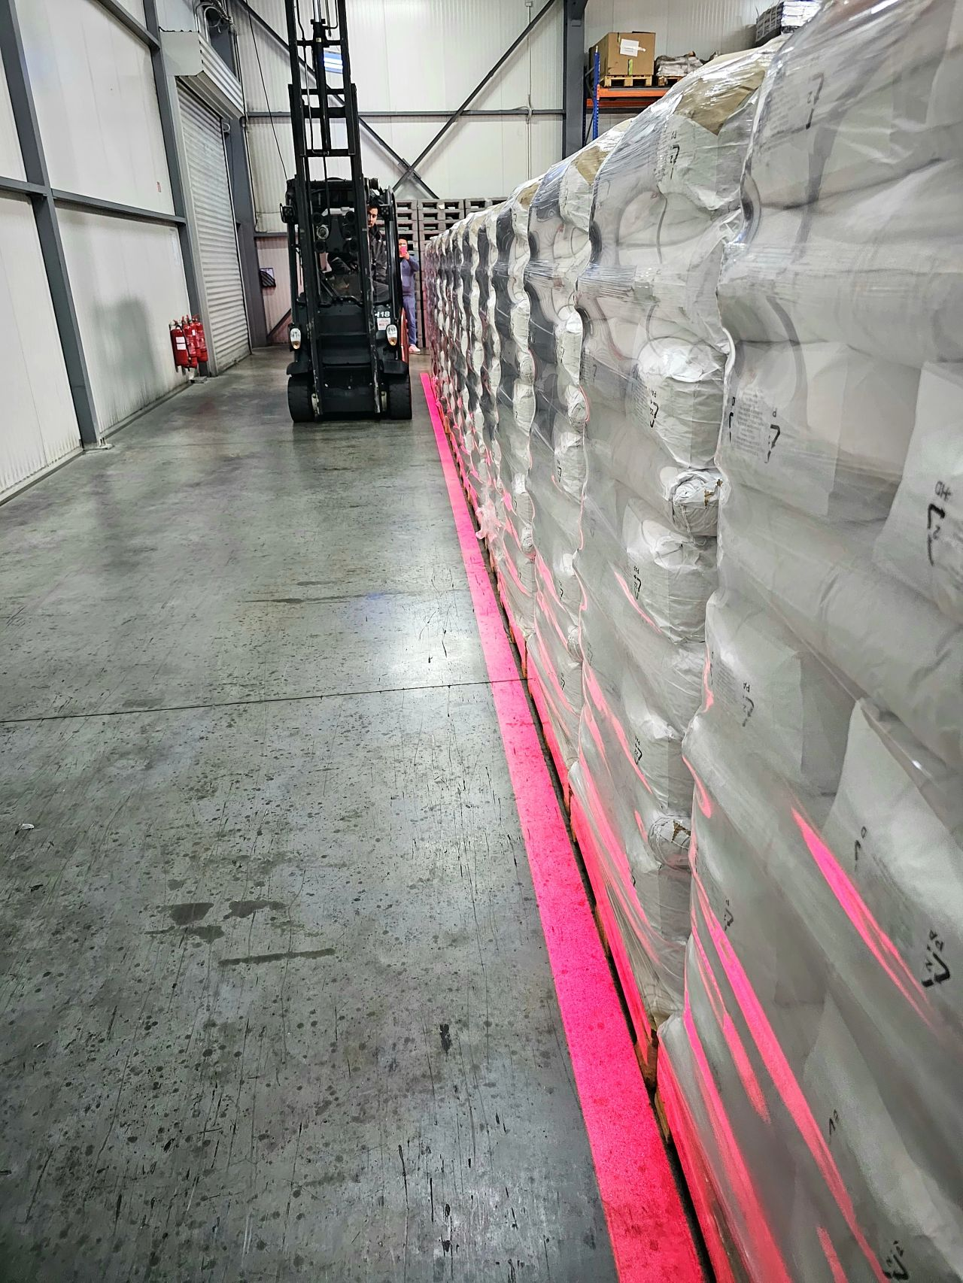
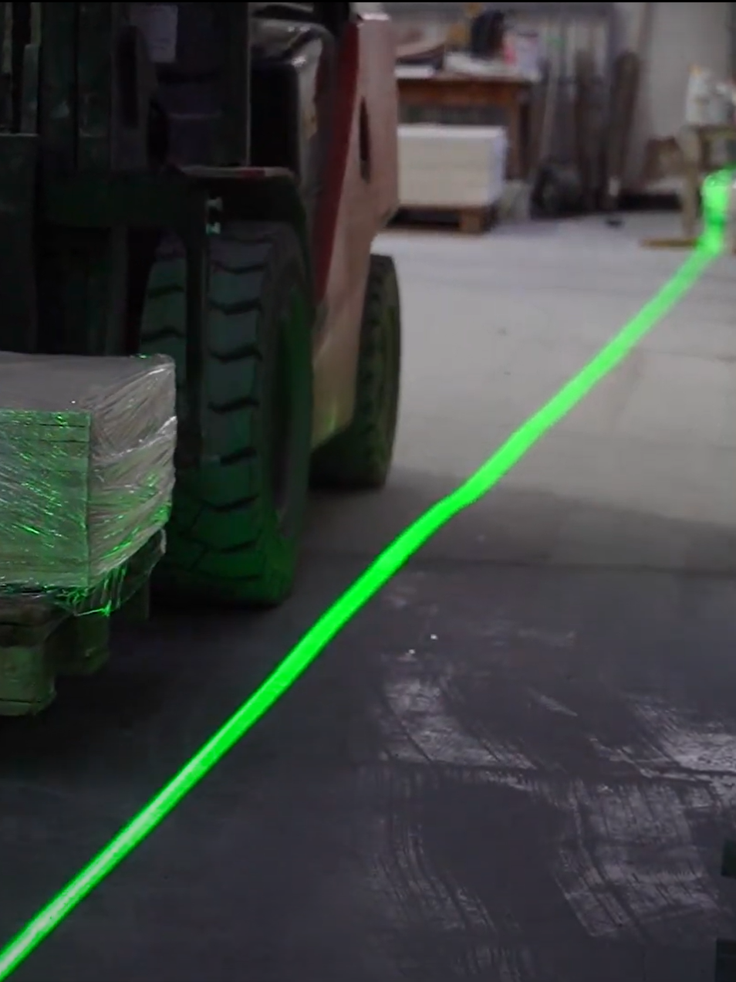
Virtual Line Marking
For high traffic, caustic or dirty environments.

Slide 17
Distributed by

