Slide 1
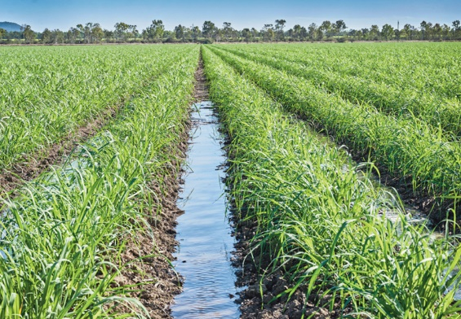
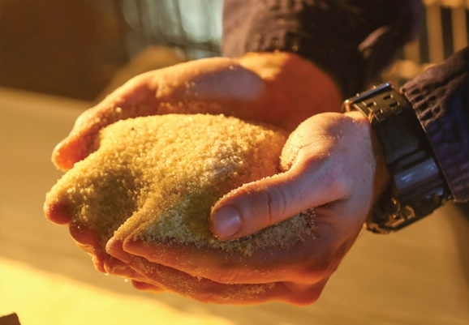
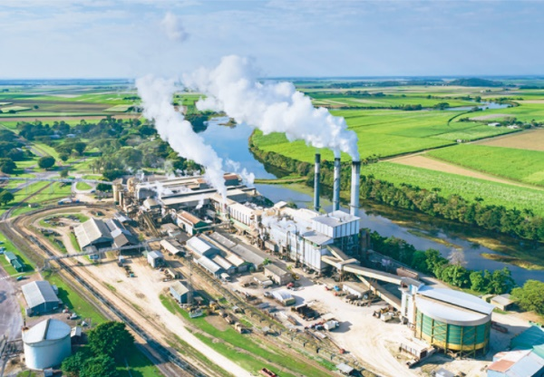

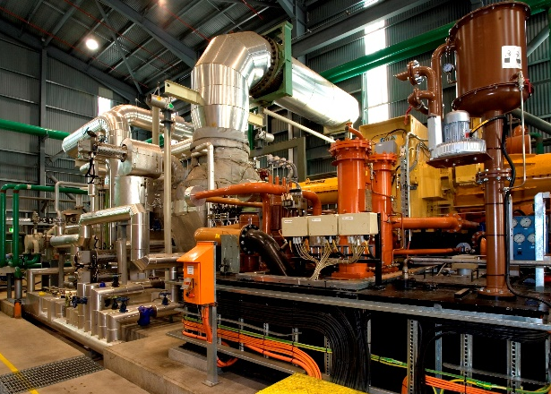

Use of Lead in Laboratories – Managing the Risk until Elimination is Possible
ASM Conference 25th March 2025
Kerrie Payne – kerrie.payne@au.wilmar-intl.com

Slide 2
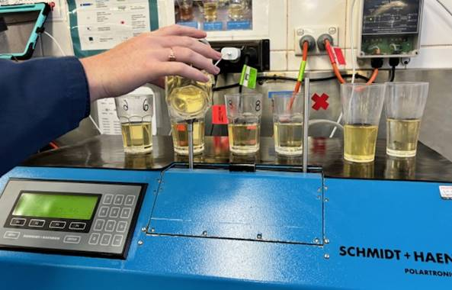
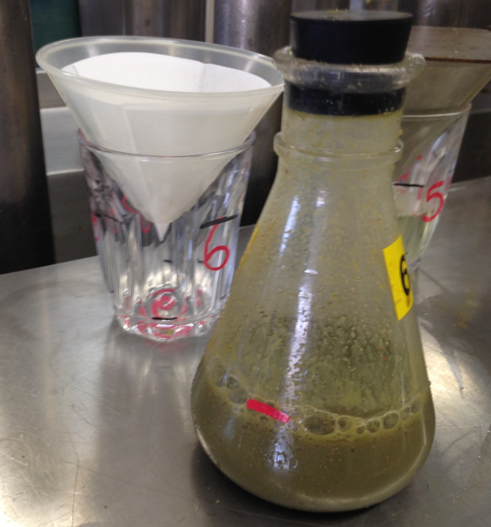
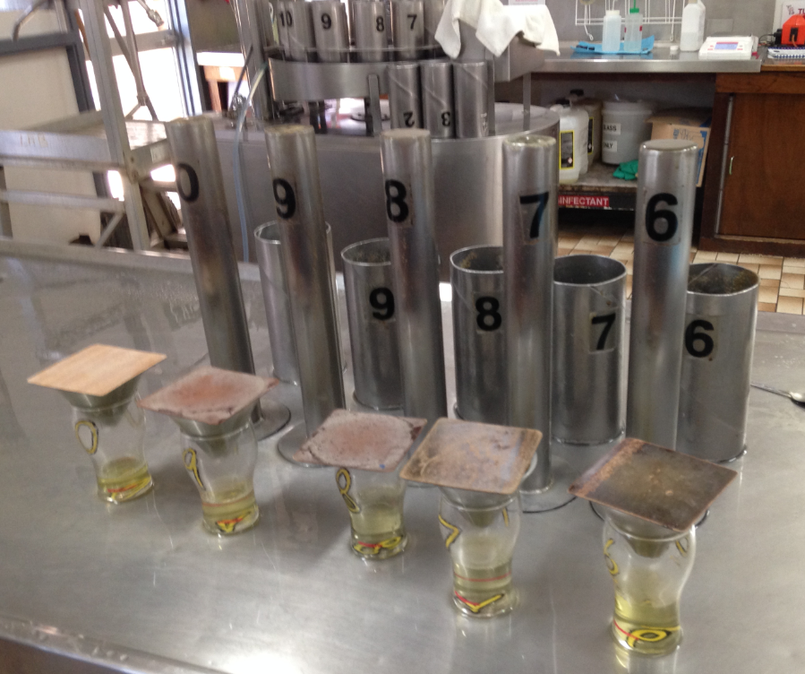
Introduction
Where do we use lead - In the analysis for cane payment and factory quality
  Cane Payment purposes as set down in the Cane Analysis Program
  Other analytical processes where lead is used:
      mud pols
      crushing juices
      bagasse analysis
      sugar pols
      other factory control analysis

Slide 3
How Does Lead Get Into The Body
  It can be inhaled through dust, fumes or mist
  It can be swallowed (ingested) e.g. when a person’s hands come in to contact with lead e.g. eating, chewing gum, biting nails, smoking and carrying smoking materials
  Lead is not easily absorbed through the skin, unless you have cuts on your hands
  Any lead absorbed will circulate in the blood where it is both slowly excreted in the urine and stored in the bones. The body can get rid of lead naturally over time, however the levels of lead may increase, if it enters the body faster than it can get rid of it.

Slide 4
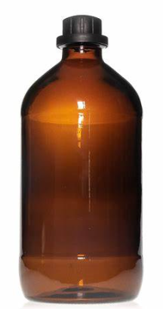
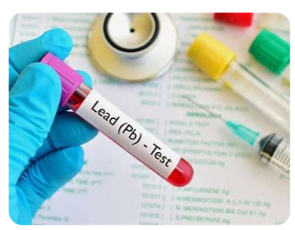
A bit of history
There have been studies completed on the use of other analytical processes that do use lead. Work completed by:
  Player MR, Rowe GS, Urquhart RM, McCunnie KA and McCarthy D (2000) Polarisation of raw sugar without basic lead acetate: international collaborative test. In: Proceedings of the Conference of the Australian Society of Sugar Cane Technologists, 385-392.
  Thai CC (2013). Studies on the clarification of juice from whole sugar cane crop. (Doctoral dissertation) Queensland University of Technology Brisbane, Australia 1: 7-26. Biological monitoring completed in the 1987
Biological monitoring conducted at CSR mills in 1987
NAT Standard for the Control on Inorganic Lead NOHSC:1012 (1994)
WH&S (Lead) Compliance Standard commenced 1st April 1996
The results of a lead monitoring program conducted by WHSQ during the 1996 crushing season determined that the use of lead in mill laboratories did not constitute a lead risk job (Australian Sugar Milling Council, 1997).
The changes in legislation 1st July 2023
  Removal of specific wording for pregnant and breast feeding females and males of reproductive capacity
  The reduction of reportable levels and the reduction of removal levels
Notes:
Talk about the development of the cane payment formula developed by Dr Kottmann of CSR in 1893
Determination of Female Reproductive Capacity: A female worker is assumed to be of reproductive capacity unless the worker provides employer with a written statement from their treating doctor. All females are classified as of reproductive capacity unless documentation from their treating GP has been received and reviewed by OP

Slide 5
Legislation
A ‘lead process” is defined in Part 7.2 of the WHS Regulation 2011 as
  “work that exposes a person to lead dust or lead fume arising from the manufacture or handling of dry lead compounds“
A “lead process area” is defined in Schedule 19 of the WHS Regulation 2011 as
  “a workplace, or part of a workplace, where a lead process is carried out”
  “lead risk work” means work carried out in a lead process that is likely to cause the blood lead level of a worker carrying out the work to exceed:
 | Previous | Updated
For a female of reproductive capacity | 10µg/dL (0.48µmol/L) | 5µg/dL (0.24µmol/L)
in any other case | 30ug/dL (1.45µmol/L) | 20ug/dL (0.97µmol/L)

Slide 6
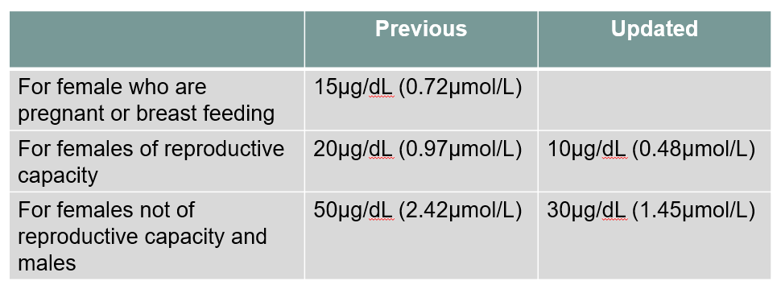
Removal from Lead Risk Work
Workers must be removed from lead risk work if:
  The confirmed blood level exceeds the exposure standards
  The Worker has a medical condition that may be adversely affected by exposure to lead
  The employer considers the worker has been exposed to an excessive level of lead

Slide 7
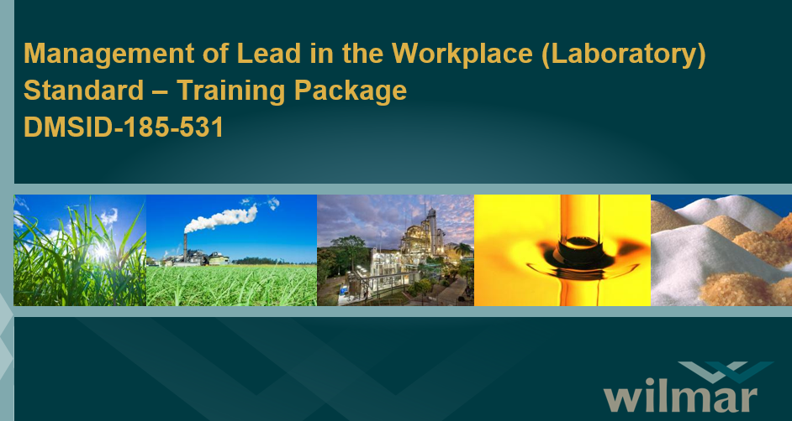
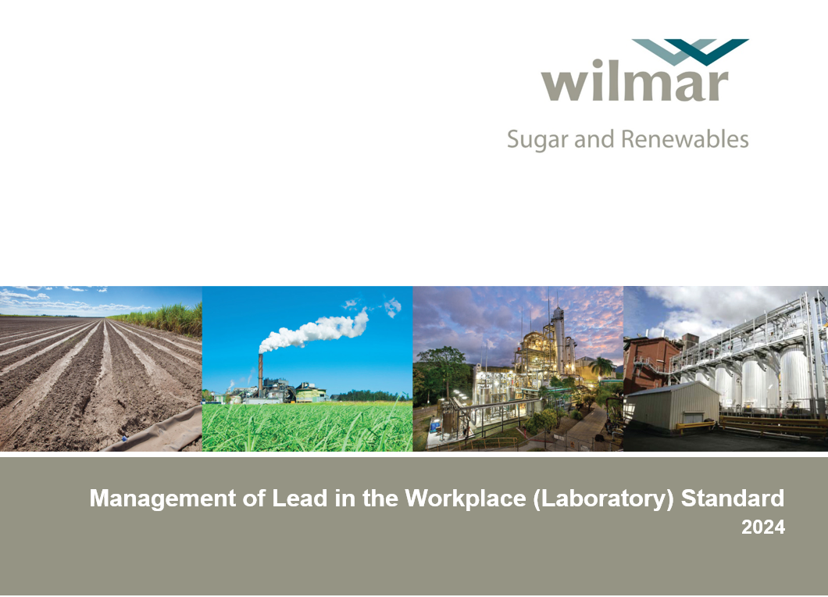
Management of Lead in Laboratory Documents
Standard
Risk Assessment for the use of Lead in Laboratories
Information Sheet for Prospective Employees
Training Package
Audit Tool
Inspection Sheet

Slide 8
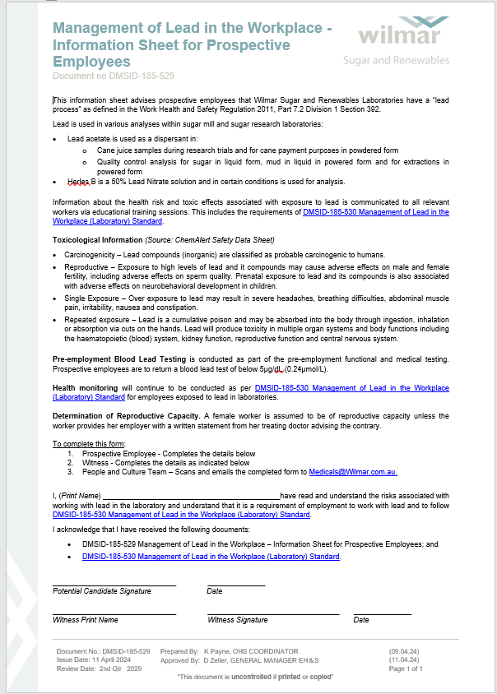
Legislation – Duty to give information
A person conducting a business or undertaking that carries out a lead process must give information about the lead process to:
  A person who is likely to be engaged to carry out the lead process
  A worker for the business or undertaking – before the worker commences the lead process.
  The information that must be given is information about the health risks and toxic effects associated with exposure to lead.
  This information is captured in DMSID-185-529 Management of Lead in the Workplace - Information Sheet for Prospective Workers.
  This is a form provided to potential Workers at the interview stage
  The form must be signed, scanned & emailed to Medicals@Wilmar.com.au

Slide 9
Biological Monitoring
Prospective Laboratory Workers are to provide a base line blood sample:
  As part of their pre-employment medical
    This blood level must be less than 5ug/dL (0.24µmol/L) or less to be able to commence employment.
  All Workers shall provide a blood sample:
  Before the worker commences work in a lead process area.
  Once four weeks of full crushing operations have been completed; a
  At the end of the crushing season, this will complete their baseline.
    When this is no further exposure to lead.
    Within 7 days of the last exposure to lead.
Additional testing requirements:
All Male Workers or Female Workers not of Reproductive Capacity.
  If the last monitoring shows a blood lead level of:
    Less than 10ug/dL (0.48 umol/L) – 6 months after the last blood lead level test
    10ug/dL (0.48umol/L) or more but less than 20ug/dL (0.97umol/L) – 3 months after the last blood lead level testing
    20ug/dL (0.97umol/L) or more – 6 weeks after the las blood lead level test.
Female of Reproductive Capacity
  If the last monitoring shows a blood lead level of:
    Less than 5ug/dL – 3 months after the last blood lead level testing.
    5ug/dL or less than 10ug/dL (0.48umol/L) – 6 weeks after the last blood lead level test.

Slide 10
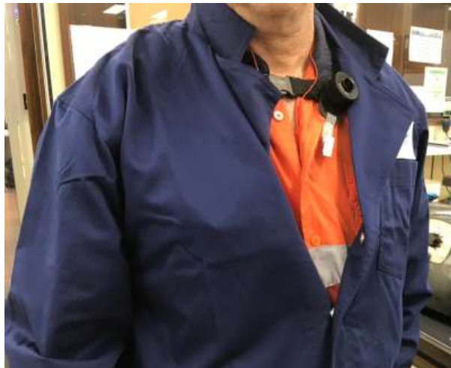
Atmospheric Monitoring
The atmospheric monitor is worn by a laboratory worker for the duration of their shift
  Wilmar undertake atmospheric testing every five years.
  This testing forms part of the risk assessment completed every 5 years.
  The last round of atmospheric testing was conducted in 2024.

Slide 11
Biological and Atmospheric Monitoring Results
Biological Monitoring
  From 1st January 2020 to 31st January 2025
    Total of 1733 lead test conducted
    Investigations of the 6 people at the reportable level
  If control measures are followed, then lead is absorbed into the blood stream and shown in the Workers blood lead test. Some examples:
    Smokers: Hand to mouth transference (Ingestion)
    Nail biters: Hand to mouth transference (Ingestion) and through open cuts on their hands (Absorption)
    Open wounds – hands/fingers: (Absorption)
    Non-work related – One from making lead sinkers and another investigated by Qld Health and Occupational Physician – determining exposure outside of work.
Atmospheric Monitoring of all positions in Lead Process areas
  In 2024 – 18 positions were monitored with an average result of 0.0014mg/m³ which is well below the NOSHC exposure standard 0.05mg/m³

Slide 12
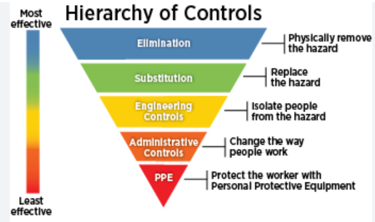
Risk Assessment recommendations
  Elimination of Lead from sugar analysis
If we eliminated lead from the analysis none of the previous would be in effect
Other analysis methods are available that do not use lead, however these cannot give the accuracy required
The current cane analysis program endorses the use of lead for pol determination in juice
PPE - Gloves
Use of gloves while using lead for analysis is not normally required; Table 1 of the risk assessment refers to the risk of exposure through absorption as being rare.
Gloves will be required to be worn if there are open wounds on the person’s hands or they bite their nails, as a necessary control measure to protect a worker from exposure

Slide 13
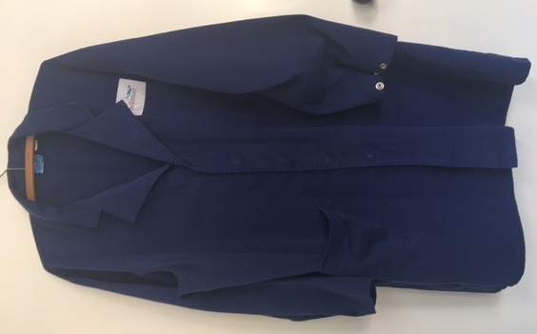
Risk Assessment recommendations - Laboratory Coats
If you are working with lead in a lead process area laboratory coats must be worn.
Laboratory coats must be:
  Worn with the sleeves secured and the buttons/clips on the front of the coat done up all the way through
  Supplied and replaced on a fair wear and tear basis
  Maintained in good condition with no holes or thinning of the material
  Laundered on site using only equipment for this purpose
  Laundered, destroyed and then placed in a plastic bag in general waste when being disposed of.
  Laboratory coats are not required for maintenance workers if working less than 1 hour in a lead process area

Slide 14
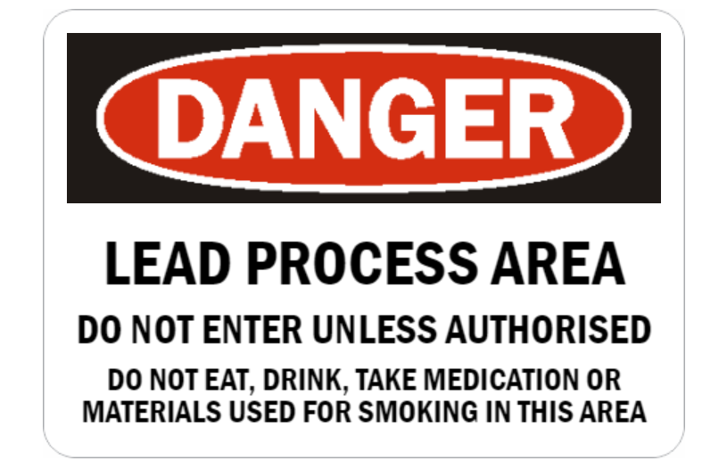
Risk Assessment recommendations - Signage
Lead process areas must have signage stating it is a lead process area
Access to the lead process areas is to be restricted to authorised personnel only.

Slide 15


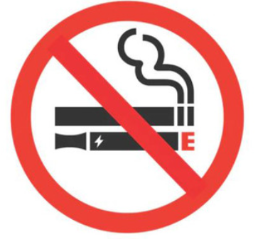
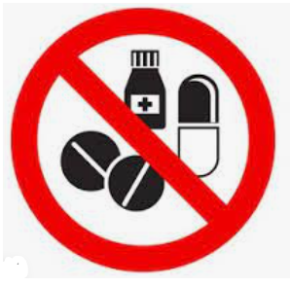
Lead Process Areas Rules
  In lead process areas the following rules apply:
  No food or drink can be taken into or be consumed in lead process areas, this includes chewing gum and lollies
  No smoking including e-cigarettes and vapes
  No materials used for smoking can be taken into the lead process area
  No medication can be taken or stored in a lead process area.
  Ensure your mobile phone is not exposed to lead e.g kept in your pocket under your lab coat, not left on benches in a lead process area.
Protect others by ensuring Laboratory visitors including other workers are aware of the lead process area rules

Slide 16

What we need to take away from this session
Lead can cause adverse effects on your health
We must continue looking at ways to eliminate lead from our analysis

