Slide 1
ASMC Safety Conference
Mackay
Duties in a contractual chain
March 2025
Mark Lalor

Slide 2
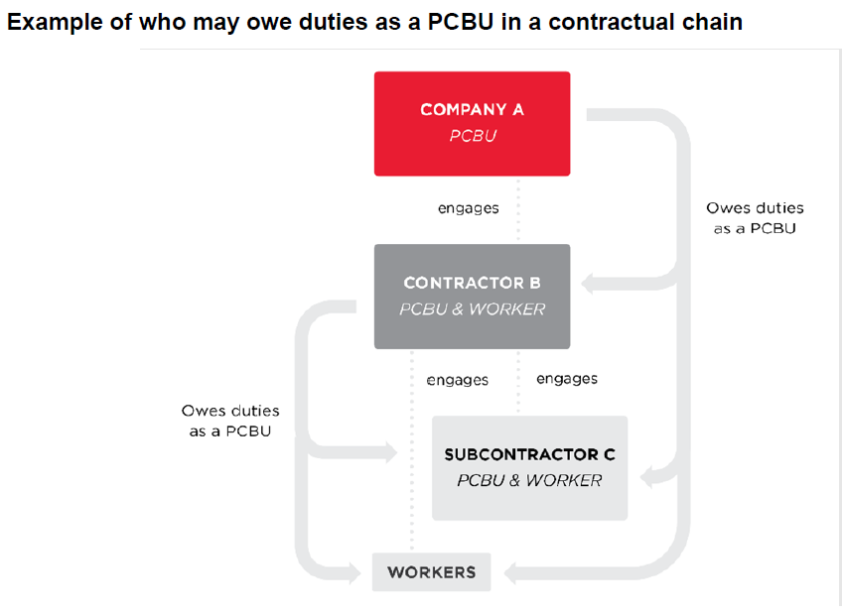
Contracting is when a business engages another business to carry out work under a contract.
What is a contractual chain?
Notes:
A contractual chain refers to the situation where, in relation to the same project or work matter, there are multiple contractors and subcontractors. There can be several levels in a contractual chain. For example, a client may engage a head contractor to undertake maintenance or deliver a logistics project. The head contractor may engage other contractors to undertake parts of the project, and these contractors may engage subcontractors to carry out particular activities that the contractor is to deliver.

Slide 3
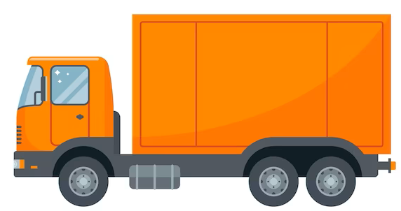
Duties in a contractual chain
What is my role in this chain?
Is there farming activities by the miller or others?
Is there sub contractors managing the farm?
Is there sub contractors harvesting on the farm?
Is cane transported from the farm over-
Farm road network
Local council road network
State or Federal main road
Notes:
WHSQ have responded to some terrible tragedies in 2024 in the cane supply area.
Along with Canegrowers and NHVR we are taking a roadshow from Cairns to Bundaberg giving guidance to the industry on their duties in these chains.
Not withstanding the factory and sub contractors fall into the same category during the maintenance season whether it is with a PC on site or external contractors assisting with maintenance.

Slide 4
Duty
Holders
14 Duties not transferable
A duty can not be transferred to another person.
15 Person may have more than 1 duty
A person can have more than 1 duty by virtue of being in more than 1 class of duty holder.
16 More than 1 person can have a duty
(1) More than 1 person can concurrently have the same duty.
(2) Each duty holder must comply with that duty to the standard required by this Act even if another duty holder has the same duty.
(3) If more than 1 person has a duty for the same matter, each person—
(a) retains responsibility for the person’s duty in relation to the matter; and
(b) must discharge the person’s duty to the extent to which the person has the capacity to influence and control the matter or would have had that capacity but for an agreement or arrangement purporting to limit or remove that capacity.
Notes:
Part 2 of the work health and safety act is titled “Health and Safety Duties”
A miller owns a farm, they engage a farm manager as an employee they use contractors to spray chemicals, fertilize and harvest from the property.
The duty of the farm manager is to identify risks and hazards to the contractors.
Contractors have duties to perform in a safe manner. This includes directors and workers of the sub contractors.
The duties of these sub contractors are not totally transferred by their engagement.

Slide 5
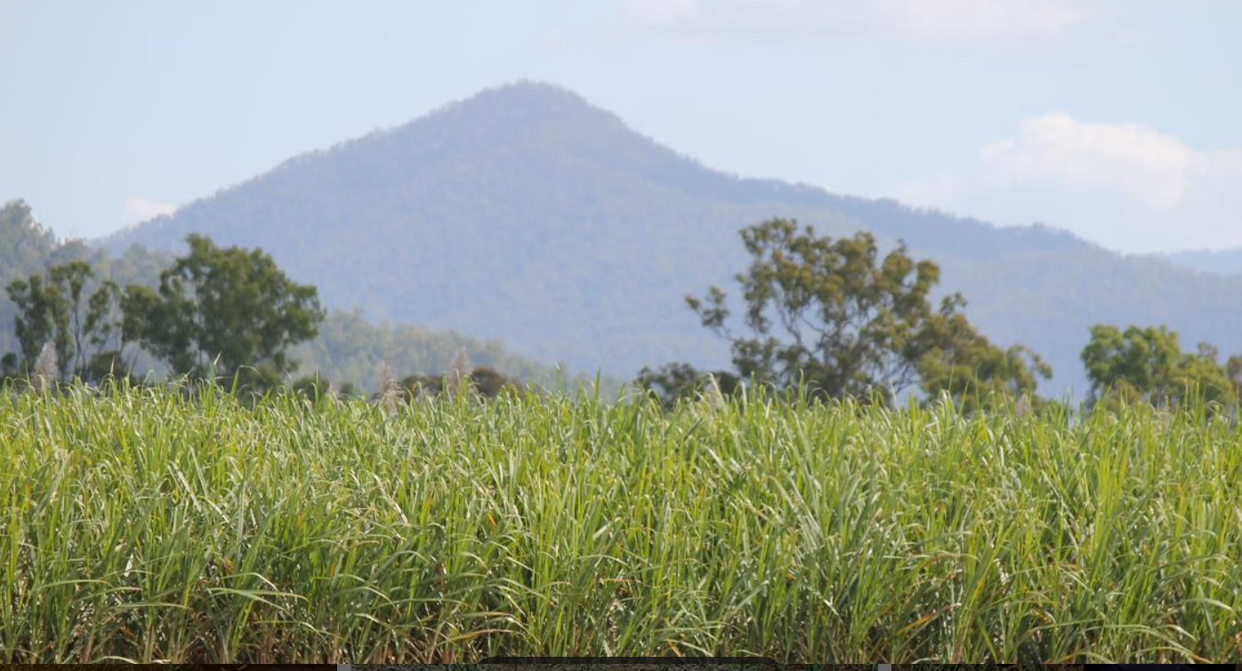
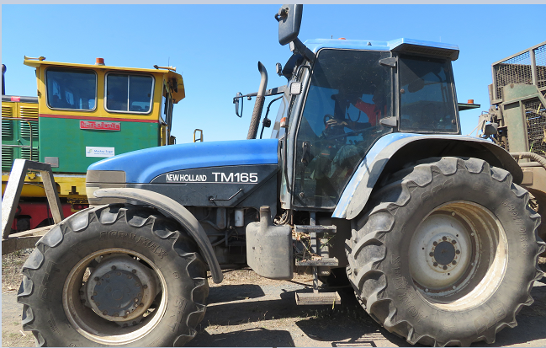
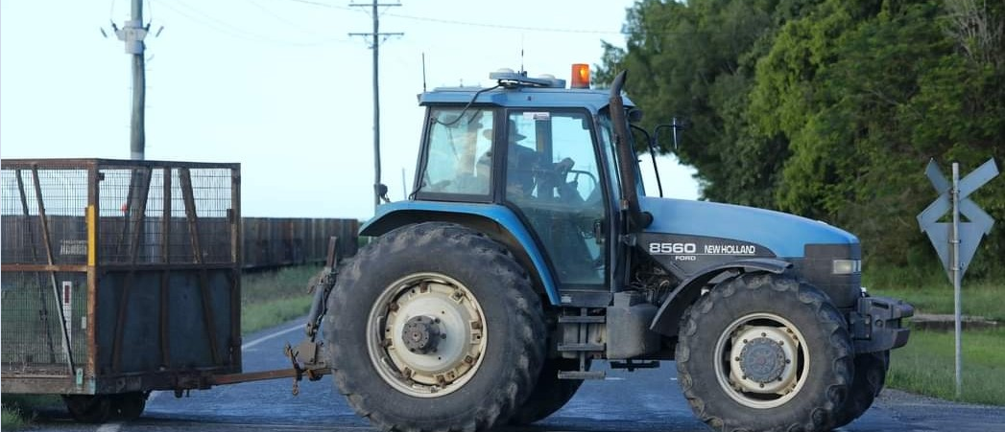
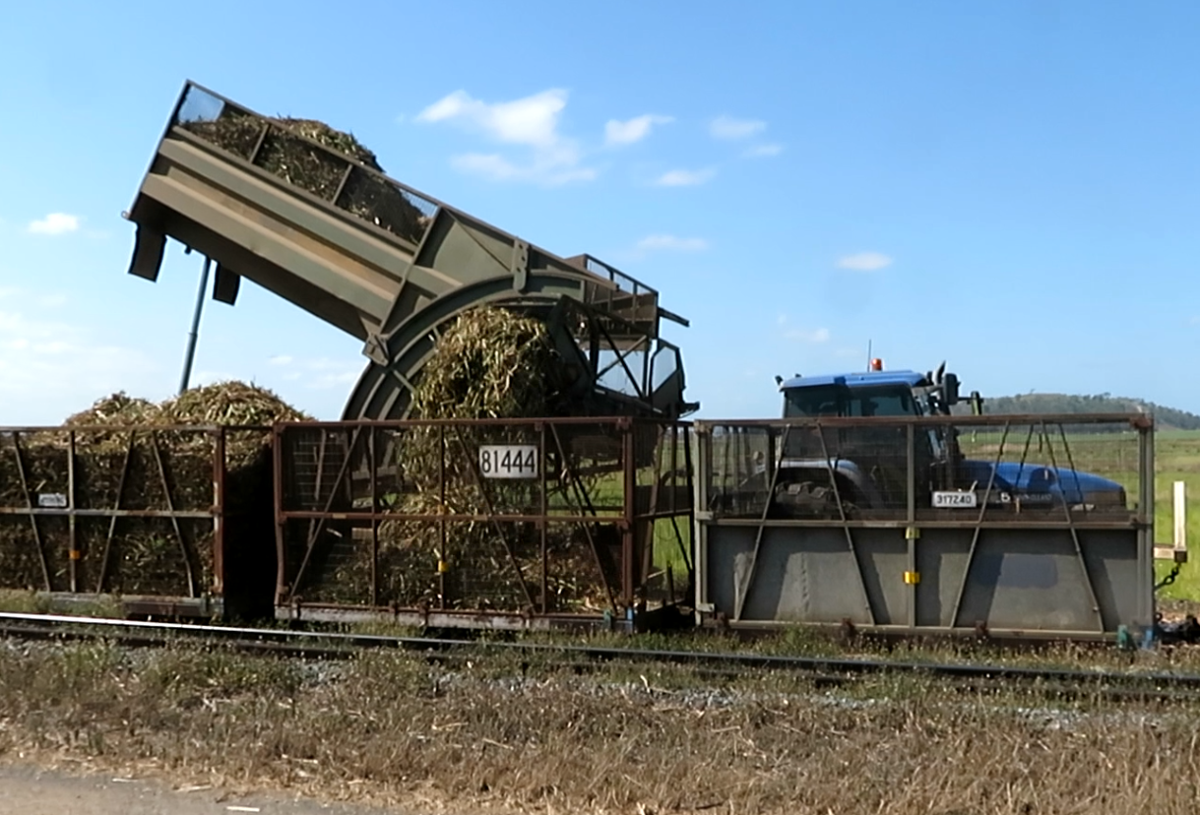
Duty
Holders
Notes:
Duty holders
The farm can be a farmer through to a company running a farm
Harvesting contractor (Sub Contractor)
Road Manager
Cane siding miller or grower owned
Cane railway

Slide 6
Who has
Duties
Persons conducting the business or undertaking (s19)
Involved in the management or control of workplaces(s20)
Involved in the management and control of fixtures fittings or plant at workplaces (s21)
Designers of plant, substances or structures(s22)
Manufacturers of plant, substances or structures(s23)
WHS Act s244 Imputing conduct to bodies corporate
(2) If an offence under this Act requires proof of knowledge, intention or recklessness, it is sufficient in proceedings against a body corporate for the offence to prove that the person mentioned in subsection (1) had the relevant knowledge, intention or recklessness.
Notes:
WHO DOES THHIS AFFECT?
PCBU
Any sub contractors coming onto site
Workers and others
People who manufacture chemicals and fertilizers. People who buy machinery for example from TEMU.

Slide 7
Who has
Duties
Cont’d
Importers of plant, substances or structures(s24)
Suppliers of plant, substances or structures(s25)
Installers of plant, or structures(s26)
Officers (s27)
Workers (s28)
Other persons (s29)
46 Duty to consult with other duty holders
If more than 1 person has a duty in relation to the same matter under this Act, each person with the duty must, so far as is reasonably practicable, consult, cooperate and coordinate activities with all other persons who have a duty in relation to the same matter.
Notes:
Duty to consult OTHERS
Who are these people
In the factory work groups who are affected by sub contractor maintenance activities.
On a farm
Deliveries
Mill mud
Fertilizer
Contractors
Irrigators
Drone operators
Aerial sprayers
Harvesting and haulout operators
Ergon
Workers and others on farm
Agronomist
Planters
Me and other government workers

Slide 8
Reasonably Practicable
Section 18 WHS Act
“must ensure so far as is reasonably practicable…the health and safety of…”
MUST – the obligation is on you
Notes:
What does reasonably practicable look like
The term ‘reasonably practicable’ is defined in the WHS Act (section 18) to mean that which is—or was reasonably able to be done—taking into account and weighing up all matters relevant to the circumstances in which the risk was considered, including:
> the likelihood of the relevant hazards or risk occurring
> the degree of harm that might result from the hazard or risk
> what the person knows about the hazard or risk and the ways of eliminating or minimizing the risk
> the availability and suitability of ways to eliminate or minimise the risk.
After assessing the extent of the risk and the ways to eliminate or minimise the risk, duty holders must also consider whether the cost is grossly disproportionate to the risk.

Slide 9
Factory
Notes:
During the maintenance season you may have contractors at points 7, 12, and 9. How does their work impact on your teams? You have to do risk assessments, consultation with your work groups and shared daily pre starts.
Point 1 may have a PC and their own work zone. Not withstanding their may be impacts outside their work area with crane lifting zones and traffic management. These have to be communicated between both parties. The owner of the site does fall under the duty holder banner even if there is a PC.

Slide 10
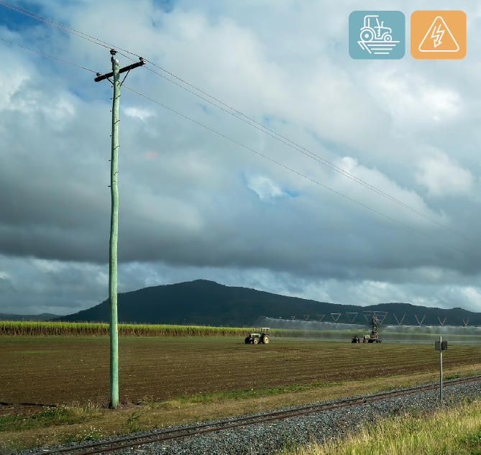
Farm
Notes:
Whether the farm is owned by the mill or a company/farmer activity inside this work area comes under WHS Laws.
We are looking for
Traffic management headlands internal roads leading to public roadways. This is WHSQ jurisdiction.
Operator competency of farm vehicles
Risk assessments and mapping on hazard areas (Drains, pumps, irrigation, OH and UG Power Lines

Slide 11
From
Farm
To
Siding
Notes:
Crossing local council roads
WHSQ are looking for
Vizibility of plant crossing the road
Competency of the operator that they can control the plant in stopping and starting
Correct road approvals
Traffic management
Risk assessments
Heavy vehicles over 4.5T come under NHVR regulations

Slide 12
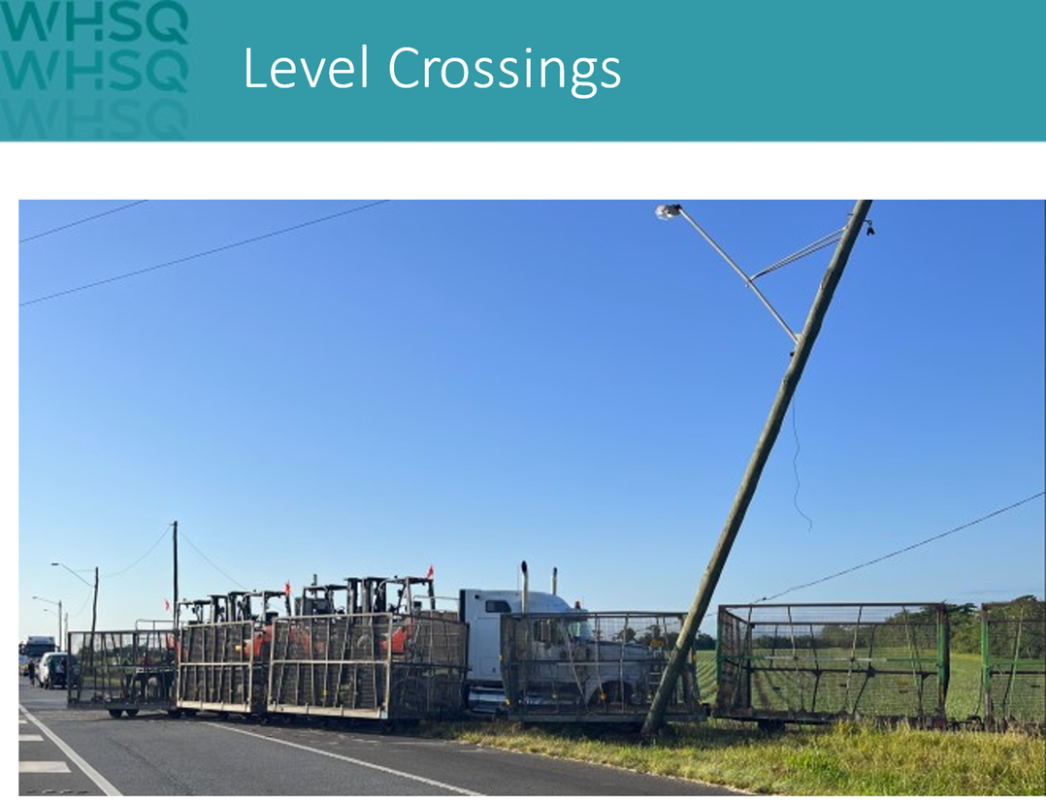
Crossing a State, Council or Federal Road
Notes:
Track Owners
ALCAM Assessments
Roadway infrastructure checked / visible / maintained on a regular basis. Engaging with the road manager.
Rollingstock visible in line with RISSB Standard 7531 lighting and visibility

Slide 13
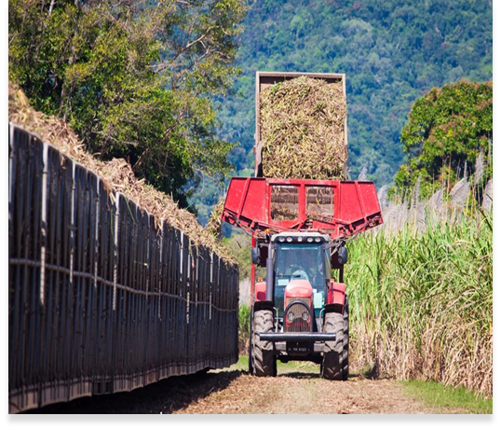
Delivery point
Mill or Farmer
owned siding
SHARED
DUTIES
WHS Act S29 Duties of other persons at the workplace
Notes:
29 Duties of other persons at the workplace
take reasonable care for his or her own health and safety; and
(b) take reasonable care that his or her acts or omissions do not adversely affect the health and safety of other persons; and
WHSQ are looking for
Siding Risk Assessments
Workers trained in the risks and any procedures, traffic management and equipment used at a siding

Slide 14
FACTORY
Engaging a
Principal
Contractor
Notes:
Depending on the situation, WHS duties may be owed by different PCBUs in a contractual chain including:
• a PCBU that engages a person or another PCBU to carry out work
• a PCBU that causes a worker to be engaged (e.g. through a subcontractor arrangement) or directs or influences their work
• a PCBU that manages or controls a workplace in which the work will take place
• a PCBU that is carrying out other work in the workplace that may affect the health and safety of those nearby.

Slide 15
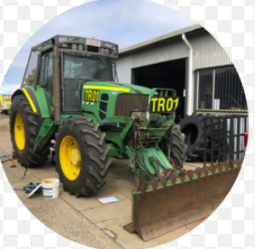
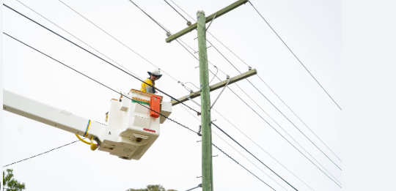
Duties of
Others
Notes:
Many contractors or entities may enter farms, factories or adjacent property,
Discharging your duty is to ensure the safety of your workers and others working in your business.
WHSQ are looking for:
Contractor management (This includes Fitness for Duty)
WARNING NEXT SLIDE TALKS ABOUT A WORKPLACE FATALITY

Slide 16
Cases Barangaraoo Ferry Hub fatality
Barangaroo construction worker killed in accident
SafeWork NSW v McConnell Dowell Constructors (Aust) Pty Limited (No. 3) -
[2021] NSWDC 105
SafeWork NSW v McConnell Dowell Constructors (Aust) Pty Limited (No. 3) [2021] NSWDC 105 - BarNet Jade - BarNet Jade
R v Brady Marine and Civil - [2020] NSWDC 775
R v Brady Marine and Civil Pty Ltd [2020] NSWDC 775 - BarNet Jade - BarNet Jade
Notes:
Unrestrained steel headstocks fell on rigger working on a barge — no adequate risk assessment for landing headstocks on barge and working upon them — deck space not cleared to lay headstocks down — no visual inspection of barge despite contractual obligation
McConnell Dowell are a good corporate citizen
The project had McConnell Dowell Management System (MMS), This MMS was certified to various international and national standards, including AS/NZS 4801:2001
Hazard register recording approximately 758 hazards
211 SWMS were prepared by subcontractors, sub-subcontractors and McConnell Dowell, most of which were reviewed and revised multiple times.

Slide 17
“It is important to note that the risk to be assessed is not the risk of the consequence, to the extent that a worker is in fact injured,
but is the risk arising from the failure to take reasonably practicable steps to avoid the injury occurring.
To discount the seriousness of the risk by reference to the unlikelihood of injury resulting is apt to lead to error.
The conduct in question is the failure to respond to a risk of injury, conduct which will be more serious, the more serious the potential injuries, whether or not they are likely to materialize.
The objective seriousness of the conduct will also be affected by the ease with which mitigating steps could have been taken.”
Judges
comments
Notes:
LOW RISK HIGH CONSEQUENCE
You have knowledge of the matter
You have capacity to influence and control
Where are your risks inside your control.
How do you communicate these risks and monitor the controls you have put in place.

Slide 18
Judges
Comments
Cont’d
Where two or more offenders are involved in the same criminal conduct or enterprise the parity principle requires that there should not be such disparity between the sentences imposed so as to give rise to a justifiable sense of grievance.
The effect of the application of the principle may vary according to the circumstances of the matter including differences between the charged offences: Green v The Queen [2011] HCA 49; (2011) 244 CLR 462 at [30].
Notes:
Brady marine had previously pleaded guilty and was fined prior to this judgement.

Slide 19
Work Health and Safety Act 2011
Part 1 Preliminary
[s 3]
Division 2 Object
3 Object
(2) In furthering subsection (1)(a), regard must be had to the principle that workers and other persons should be given the highest level of protection against harm to their health, safety and welfare from hazards and risks arising from work or from particular types of substances or plant as is reasonably practicable.
Why
we
are
here
Notes:
Work Health & Safety Act

Slide 20
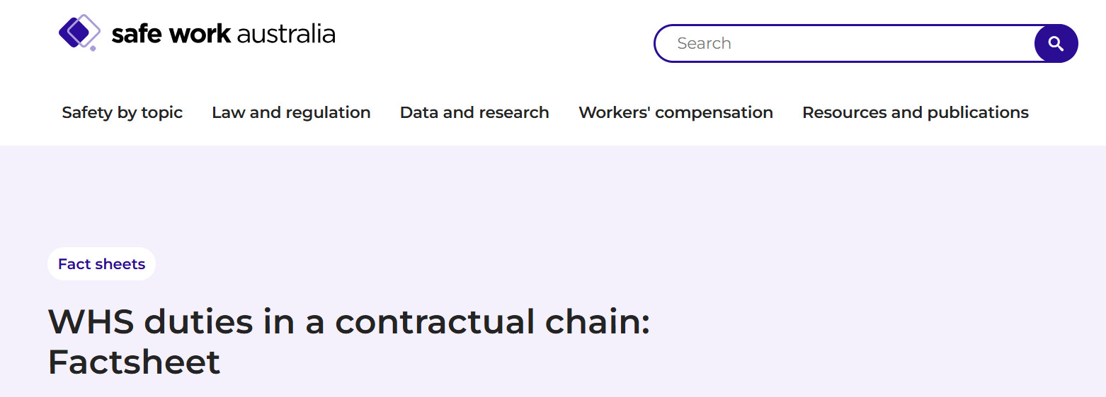
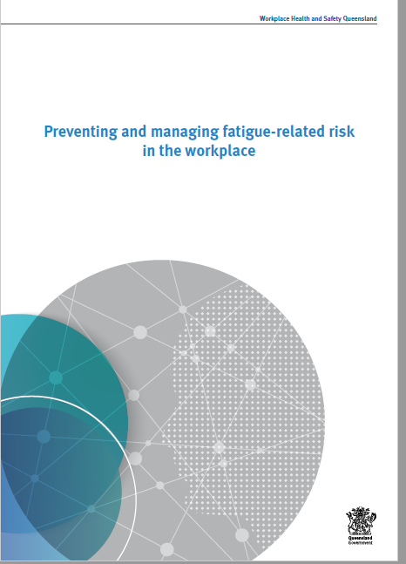
Resources
WHS duties in a contractual chain: Factsheet | Safe Work Australia
Fatal incident during cane harvesting operations | WorkSafe.qld.gov.au

