Slide 1
Industry Insights and Emerging Trends
Paul Love, Senior Account Manager
25 March 2025

Slide 2
About WorkCover

Slide 3
Working together
WorkCover Queensland
Provides and manages workers’ compensation insurance for Queensland employers and workers
Minister for Industrial Relations
Develops legislation for workers’ compensation, work health and safety, and electrical safety
Office of Industrial Relations
Includes Workplace Health and Safety Queensland, Workers’ Compensation Regulatory Services, and the Electrical Safety Office
Notes:
The Minister for Industrial Relations develops legislation for workers’ compensation, work health and safety and electrical safety.
WorkCover Queensland
An independent government owned statutory body, is a customer focused insurer aiming for insurance excellence. Despite it being mandatory for all Queensland employers to hold a WorkCover accident insurance policy (unless employers hold a self-insurance licence), WorkCover strives to be competitive with commercial insurers and is branded as such. The approach is simple: build lasting, valued relationships with customers and stakeholders. This means understanding and meeting customers' needs and evolving business processes to suit these needs.
About WorkCover:
We provide tailored workers’ compensation services
Our scheme allows workers to apply for compensation no matter who, or what caused their workplace injury
We have an excellent return to work rate because we passionately advocate the health and productivity benefits of work
Our fast, easy to use online services save employers and injured workers time and money and cut red tape for business.
We manage claims in-house to save you time and money.
Office of Industrial Relations
Workplace Health and Safety Queensland
Is responsible for improving workplace health and safety in Queensland and helping reduce the risk of workers being killed or injured on the job. WHSQ enforces work health and safety laws, investigates workplace fatalities, serious injuries, prosecutes breaches of legislation, and educates employees and employers on their legal obligations.
Workers’ Compensation Services include:
The Workers' Compensation Regulator
The Workers' Compensation Regulator (the Regulator) plays a diverse range of roles including regulator, facilitator of legal and medical resolution, educator and promoter of the workers' compensation scheme in Queensland.
The Regulator works closely with scheme partners and stakeholders to balance the needs of workers and employers and ensure a fair and efficient scheme for all.
The Regulator is passionate about continuing to innovate and develop services and initiatives that better serve the industry, and ultimately ensure that injured workers can safely return to the workplace after a workplace injury.
Electrical Safety Office
The Electrical Safety Office (ESO) develops and implements legislative, compliance and enforcement frameworks to improve electrical safety.
The ESO enforces standards for electrical safety and promotes strategies for improved electrical safety performance across the community
Though we remain separate organisations, we continue to work together to deliver efficiencies for Queensland businesses and the broader community.

Slide 4
Highlights from 2023-2024 annual report
Our organisation |  | Our employers |  | Our workers
$1.29 average premium rate per $100 of wages | $6.436B funds under management ​ | 179,024 employers insured ​ | $96.5M premium savings for employers ​ | $1.46B statutory benefits and entitlements paid to workers ​ | 90.4% injured workers returned to work ​
312,767 customer calls to our contact centre | 89% People survey response rate | $32.04M premium raised from non-compliant employers | 539 onsite audits by our compliance advisors | 74,127 injured workers supported through a claim | 3,241 new common law claims
10,219 referrals to return to work providers ​ | 68%​ employee engagement score ​ | 120 employers engaged with IPaM program ​ | 7.2/10​ average customer experience rating by employer ​ | 7.2/10​ average customer experience rating by workers ​ | 3,364 workers with a primary mental injury claim ​
Notes:
Talking points
Net increase of 2,000 more insured employers
IPaM – 2000 total employers engaged so far. Available to any QLD Employer with a WCQ policy.
6000 additional workers assisted compared to FY22/23
Leading to a $250m increase in claims costs.
FY22/23 average rate $1.23

Slide 5
Manufacturing Industry
Sugar and Confectionary Manufacturing

Slide 6
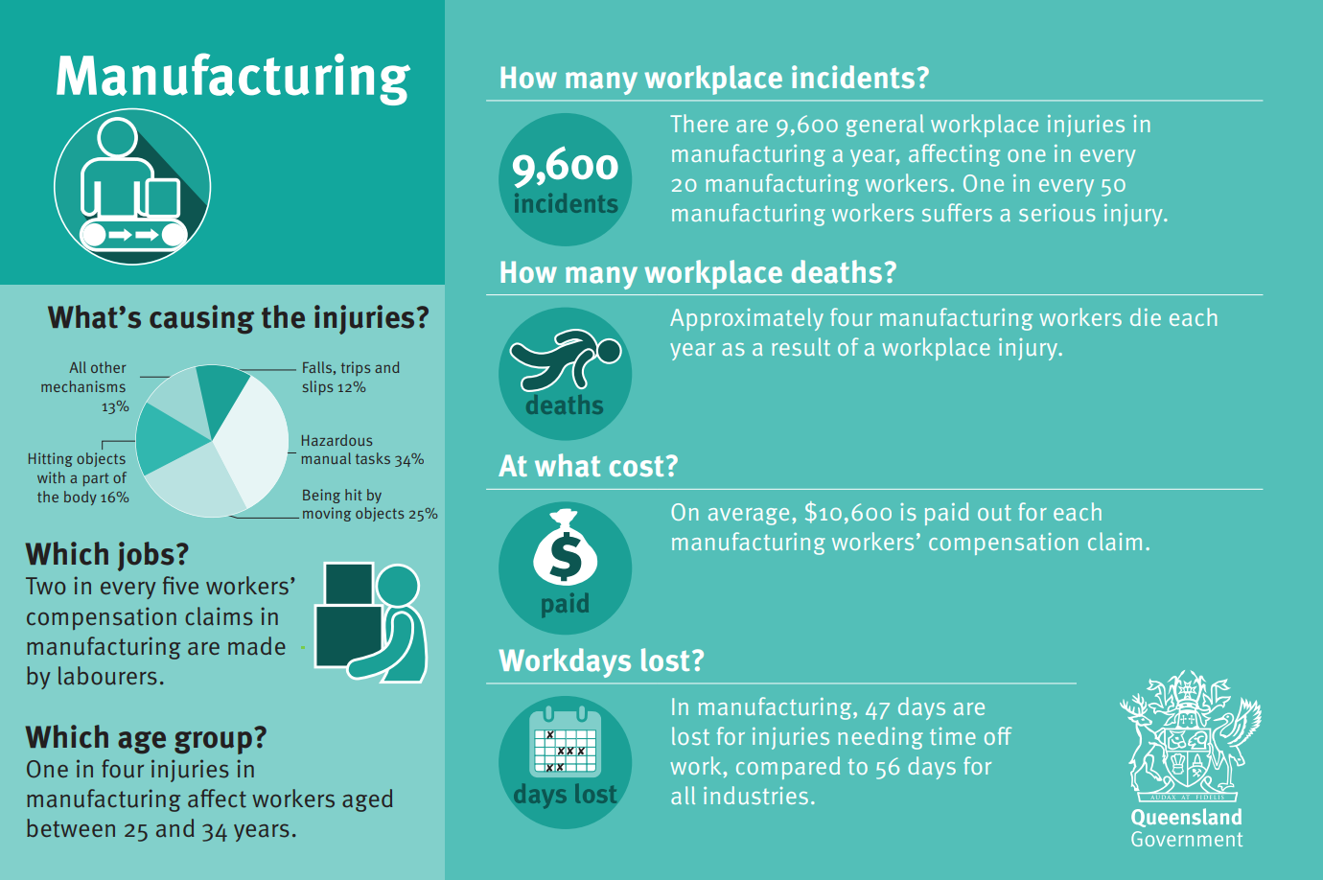
Industry Snapshot
(23/24 Financial Year)
How does this Compare to 22/23 Financial Year?
17% reduction in general workplace injuries.
1 further fatality due to workplace injury
27% increase in workers compensation claims costs.
32% increase in loss time days.
Taken from www.worksafe.qld.gov.au – manufacturing industry infographic postcard
Notes:
Overall industry snapshot, not just of WCQ claims.
9600 incidents across whole industry, across all insurers and employers, not just WCQ.

Slide 7
Injury claims per year
All industries
2023 - 2024
ACCEPTED STATUTORY CLAIMS 74,127 +8.0% from 2022-2023
STATUTORY COMPENSATION PAYMENTS $1.46B +15.8% from 2022-2023
AVERAGE ANNUAL STATUTORY CLAIM COST $12,700 +9.1% from 2022-2023
AVERAGE WEEKLY COMPENSATION PAID DAYS 54 +3.0% from 2022-2023
ACCEPTED STATUTORY CLAIMS 8,821 +3.8% from 2022-2023
STATUTORY COMPENSATION PAYMENTS $131.7M +1.7% from 2022-2023
AVERAGE ANNUAL STATUTORY CLAIM COST $10,700 +6.9% from 2022-2023
AVERAGE WEEKLY COMPENSATION PAID DAYS 47 +2.8% from 2022-2023
Manufacturing
2023 - 2024
Numbers have been rounded for presentation purposes
Some measures can be subject to minor changes over time
Definitions for average cost of statutory claim and annual paid days (average days off work) have changed, so these numbers cannot be compared with those published in prior years
Numbers may be different to scheme-wide data reported by the Office of Industrial Relations, which includes self-insured employers
Notes:
Workcover claims only data
We are seeing an increase in claim numbers coming through; however, this is also a byproduct of an increased reporting culture. This is a good thing however, and we would rather see the claims early, than 6-12 months down the track.
Increase in claims cost – with this being driven by psychological and psychosocial aspect predominately, however also seeing a small increase in injury severity.
Will speak to the psychosocial aspect in a later slide, and to the importance of early intervention in this space.
Average paid days – per the above.

Slide 8
Manufacturing Industry Data
The follow slides provide a high-level overview of the Sugar Industry, and their Queensland Workers Compensation claim injuries, the injury nature and location, and durations.
This data is based on accident insurance policies held by WorkCover Queensland and classified as having a specific sugar manufacturing industry classification.

Slide 9
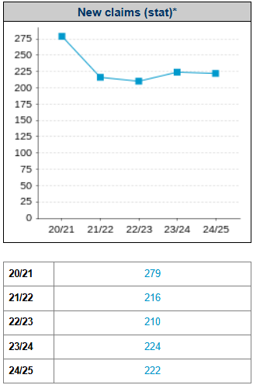
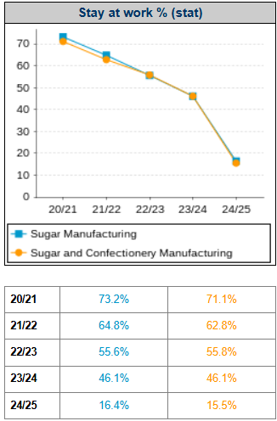
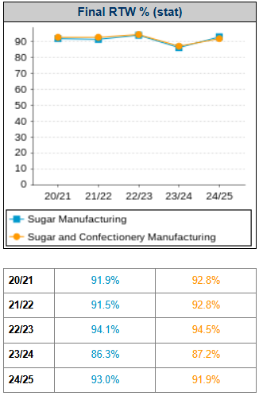
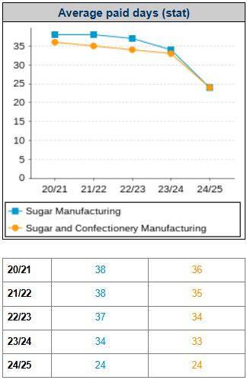
Statutory Claim Indicators
Claims where first accepted liability is for medical expenses only.
Claims where workers have returned to work in some capacity at the conclusion of their claim
Average days paid of time loss before a worker returns to work

Slide 10
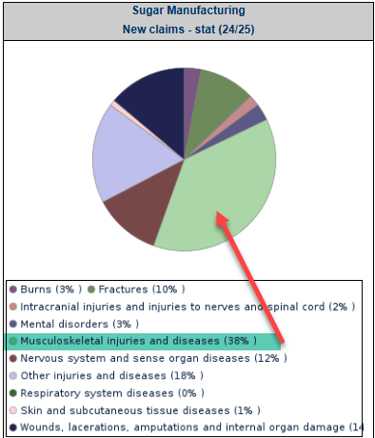
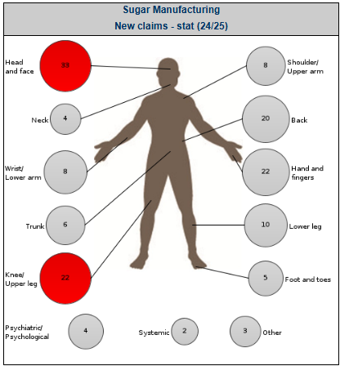
Industry Injury Summary
For the Sugar Manufacturing Industry as a whole, musculoskeletal injuries continue to trend as the most frequently occurring injury type, accounting for 38% of total injuries.
This is followed by Wounds, lacerations at 14% of total injuries.
Broken down to body location, injuries to the head and face (e.g lacerations, musculoskeletal and intracranial injuries) are the most commonly occurring.
This is followed by injuries to the knee and upper leg.

Slide 11
Emerging Trends and Opportunities
▪ Musculoskeletal Disease Injuries continue to be the leading nature of injuries across all industries. Identifying areas of opportunity, or of high risk, or that have previously caused injury and addressing work design for hazardous manual tasks with a focus on eliminating the hazards by identifying the risks can lead to significant reductions in injury.
▪ IPaM – Injury Prevention and Management
Resources:
✓ Health Benefits of Good Work- Worksafe.qld.gov.au
✓ Employer Return to Work Guide – Worksafe.qld.com.au
✓ Overcoming challenges – Worksafe.qld.com.au
✓ Mentally healthy workplaces - LeadingWell QLD
✓ People at Work survey - peopleatwork.gov.au
✓ IPaM Worksafe.qld.com.au
Notes:
IPaM – 2000 total employers engaged so far. Available to any QLD Employer with a WCQ policy.
Can approach WCQ to ask to engage in this program, and this is done through the website, or by approaching your relationship manager at WCQ.
Discuss system of work design – and how understanding system of work, and looking at work design can reduce high risk or repetitive injuries.

Slide 12
How best to support your worker during recovery​
Provide access to medical treatment immediately
Early intervention is key. Ensure access to other supportive measures is provided early – EAP, EIP or Mates In Manufacturing.
Discuss and offer return to work options – light or alternative duties​
Get input from the worker, their doctor and other treating practitioners
​
Keep talking to the worker about their progress.

Slide 13
Mental injury claim trends

Slide 14
Data source and definitions: Office of Industrial Relations Queensland workers’ compensation scheme statistics 2022-23
*Average finalised, time lost claims
Mental injury trends
Mental injury claims 2022-2023 for the Scheme (including self-insurers)
​ | New claims (lodgments)​ | Cost per claim*​ | Average days off work​
Statutory claims​ | 92,547​ | $27,643​ | 72.3​
Mental injury claims​ | 6,318​ (around 6.8% of total statutory claims)​ | $68,136​ | 199.7​
​ | ​ | Mental injury average cost per claim increased by 11.6% from 2021-2022​ | Mental injury average days off work increased by 10.1% from 2021-2022​
The total statutory benefits paid by WorkCover for primary mental injuries has increased from $51M (in 2017-18) to $209.2M in 2023-2024.
73.3% of workers with a primary mental injury returned to work compared to 93.3% for workers with a physical injury.
There is an increasing focus on the benefits of early intervention with all involved parties, and the benefits of continued communication and collaboration from a supportive employer. Recent data compiled by WorkSafe Queensland suggests when workers perceive their employer's response to their injury as fair and constructive, their RTW rate is between 43% to 52% higher, leading to reduced claims costs and more sustainable outcomes.

Slide 15
Managing the risks of psychosocial hazards at work Code of Practice 2022
WorkCover does not administer this Code. The below is general information only, and further details should be sought independently.
The Code of Practice is legally enforceable by Workplace Health and Safety Queensland.
The Code is a practical guide on how to prevent harm from psychosocial hazards at work, including psychological and physical harm.
It does not create a new work health and safety duty or expand existing duties, rather it provides clarity through practical guidance for employers about their existing legal obligations.
Notes:
Employers should seek their own advice on what this means for them. Check out the WorkSafe Qld website and contact Safe Work Australia if they have questions.

Slide 16
Managing the risks of psychosocial hazards at work Code of Practice 2022
WorkCover does not administer this Code. The below is general information only, and further details should be sought independently.
Psychosocial hazards are anything at work that may cause psychological or physical harm. These stem from:
the way tasks or a job are designed, organised, managed and supervised
tasks or jobs where there are inherent psychosocial hazards and risks
the equipment, working environment or requirements to undertake duties in physically hazardous environments, and social factors at work, workplace relationships and social interactions.
Notes:
Employers should seek their own advice on what this means for them. Check out the WorkSafe Qld website and contact Safe Work Australia if they have questions.

Slide 17
Thank you

